Slide 1

Notes:
# Welcome!

Slide 2
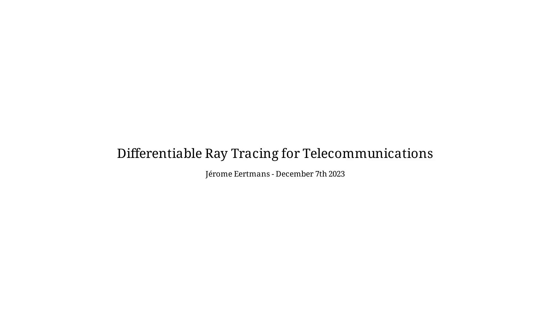
Notes:
# Audio propagation analogy
I like to introduce my subject with a small analogy.

Slide 3

Notes:
Let the speaker emit audio waves towards the audience.

Slide 4

Notes:
Let us focus on one of the listeners.

Slide 5

Notes:
In free space, sound arrives in a direct path.

Slide 6
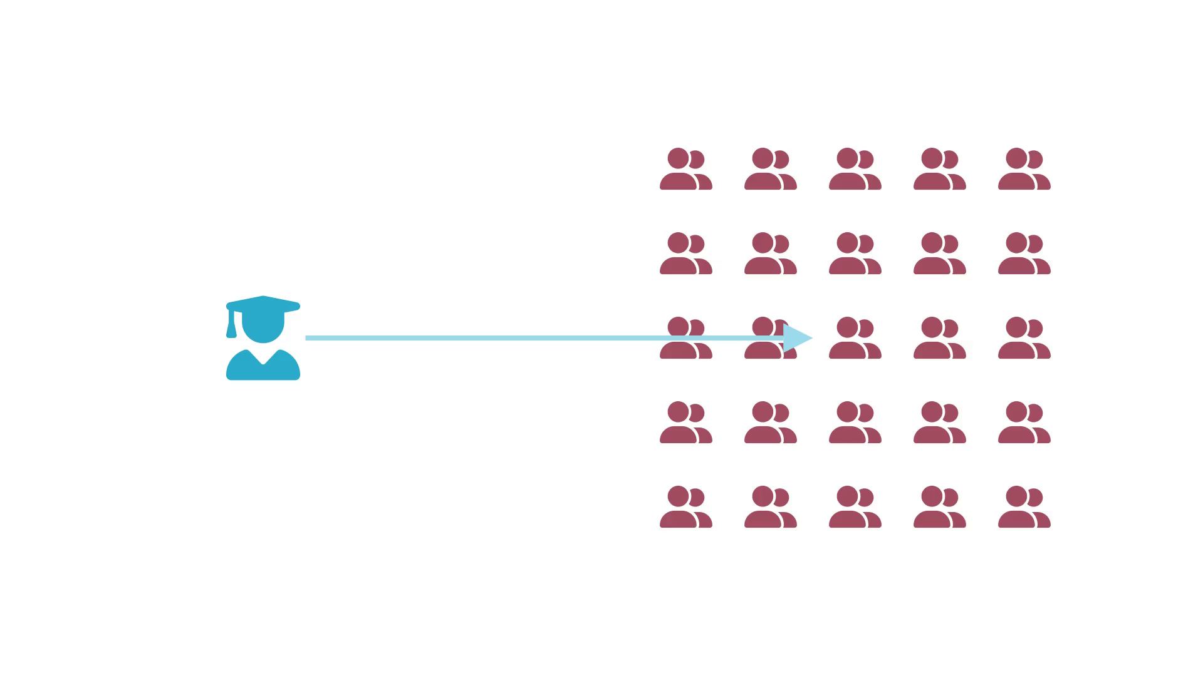
Notes:
But what if we have a wall?

Slide 7
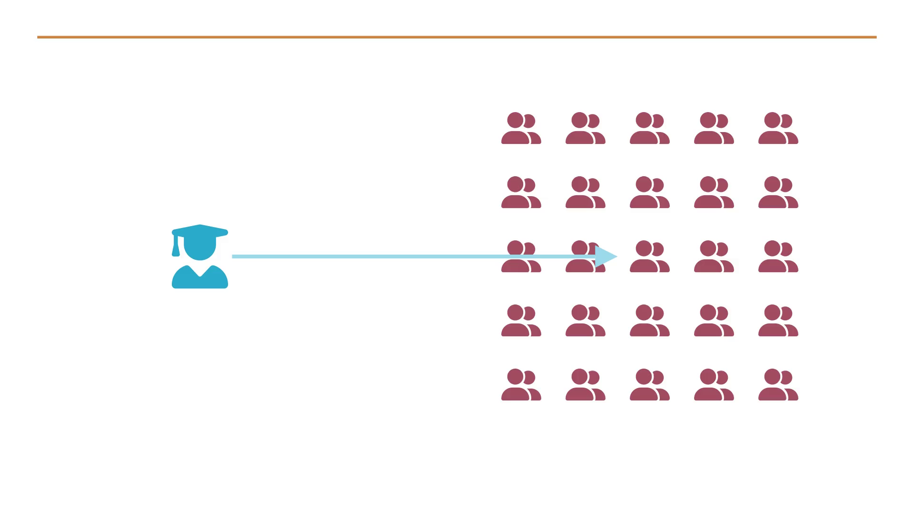
Notes:
Like in a tunnel, the sound waves will reflect on this wall,
and reach the listener a second time, with a different delay and volume.

Slide 8
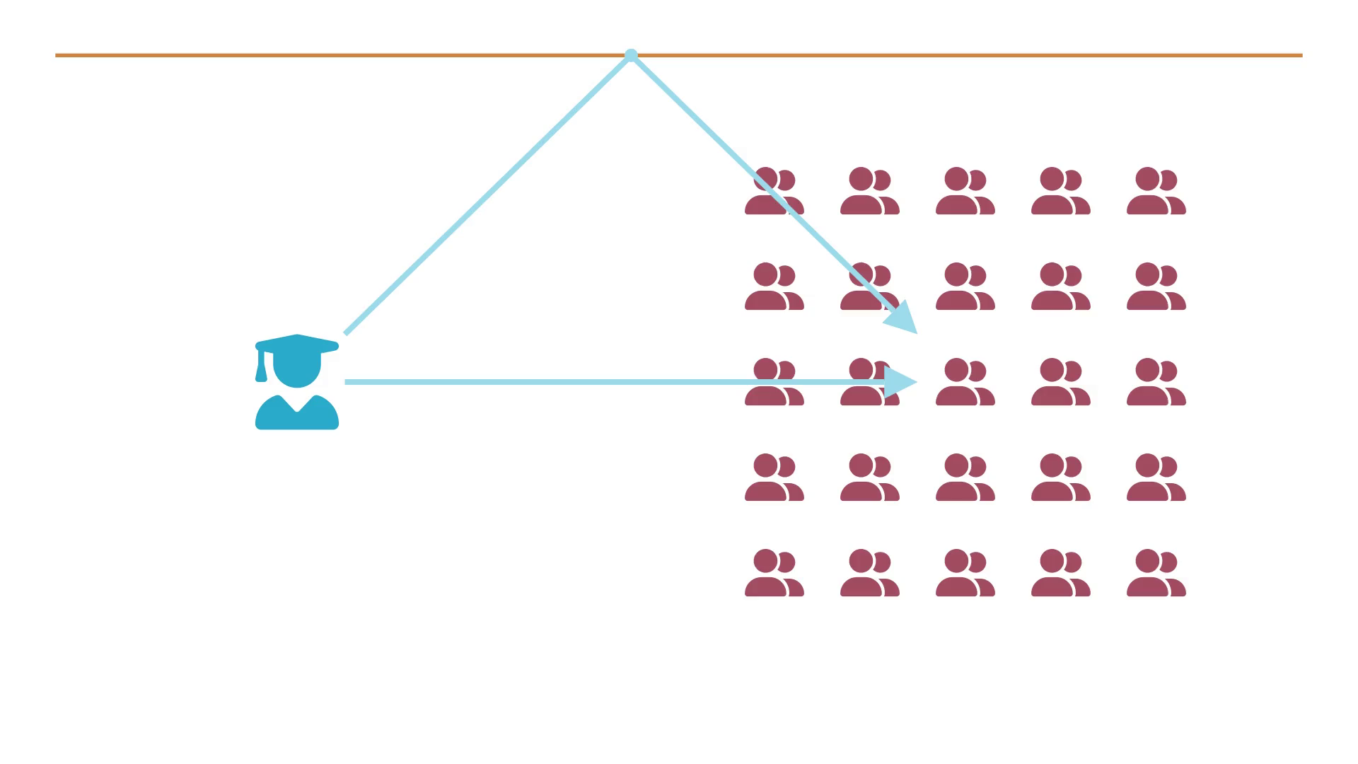
Notes:
Of course, we can have many walls.

Slide 9
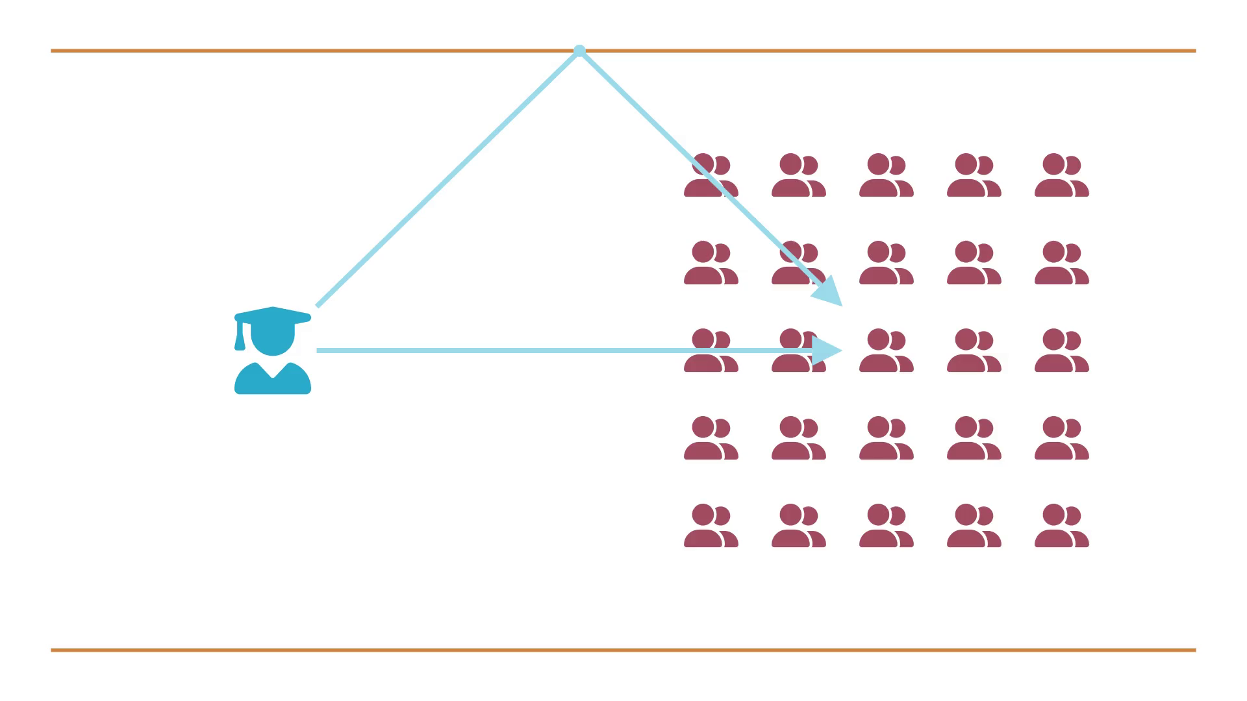
Notes:
Or obstacles that obstruct some paths.

Slide 10
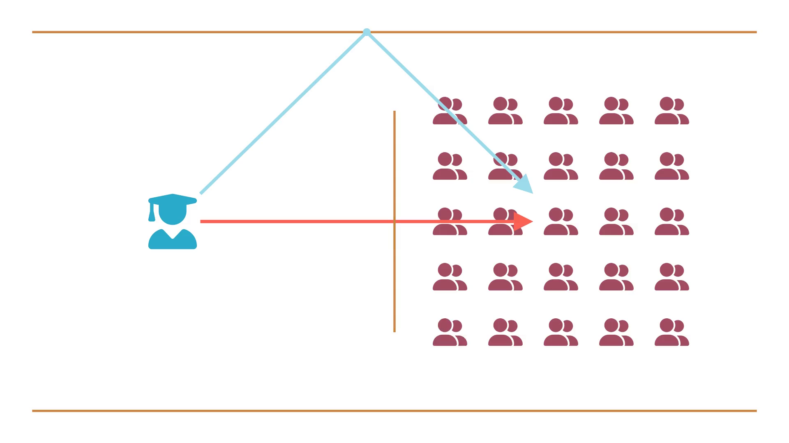
Notes:
What if the target changes?

Slide 11
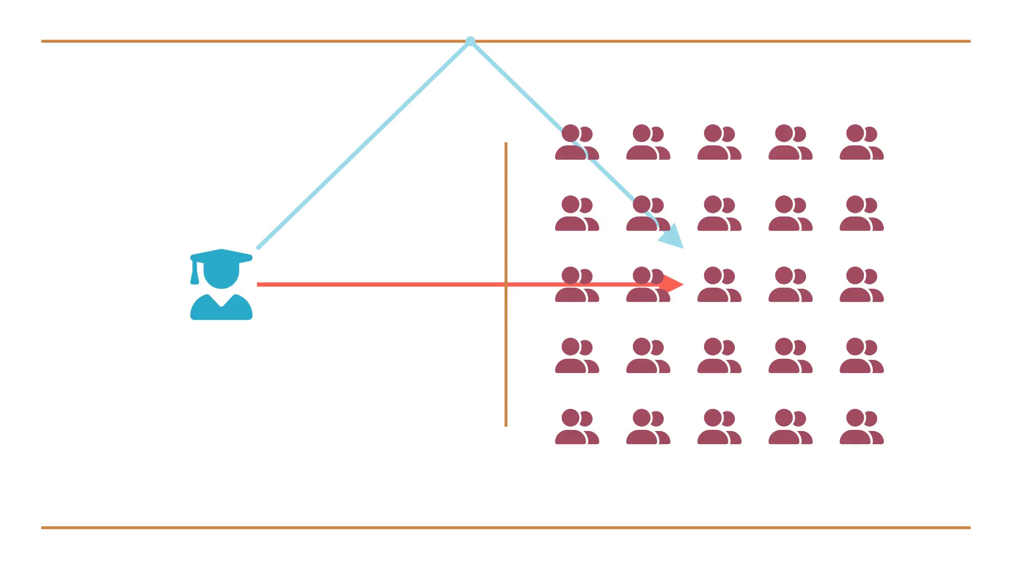
Notes:
Of course, the same logic can be applied to radio networks.

Slide 12
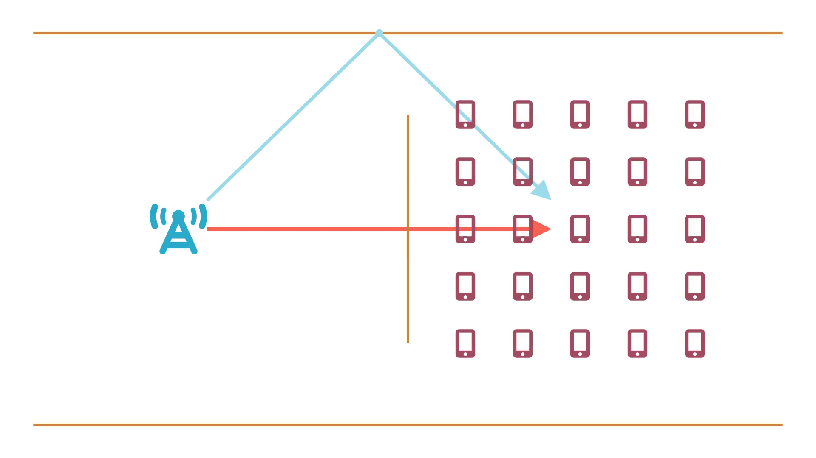
Notes:
What we did, if actually called Ray Tracing (RT)

Slide 13
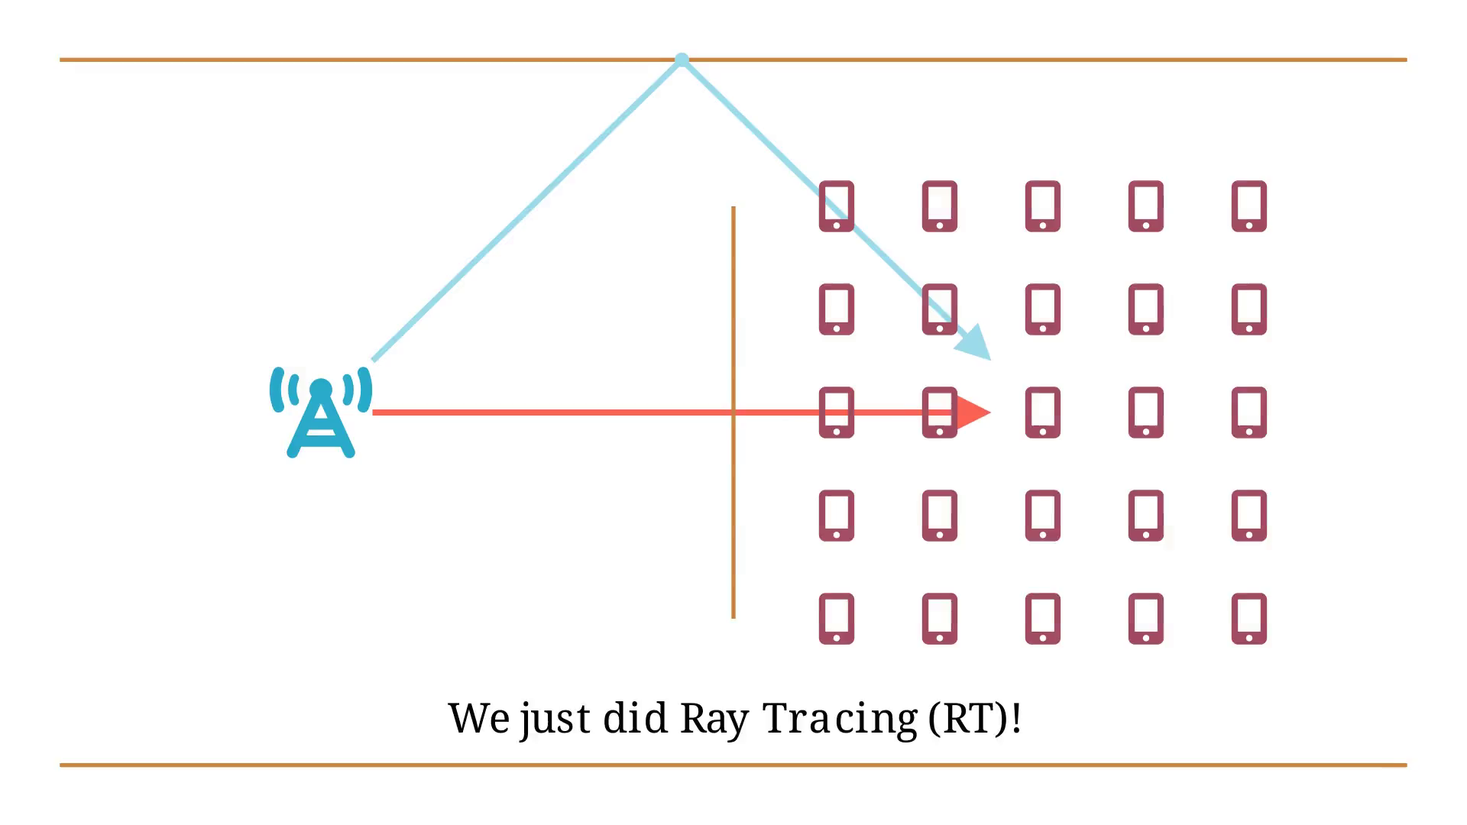
Notes:
Table of contents

Slide 14
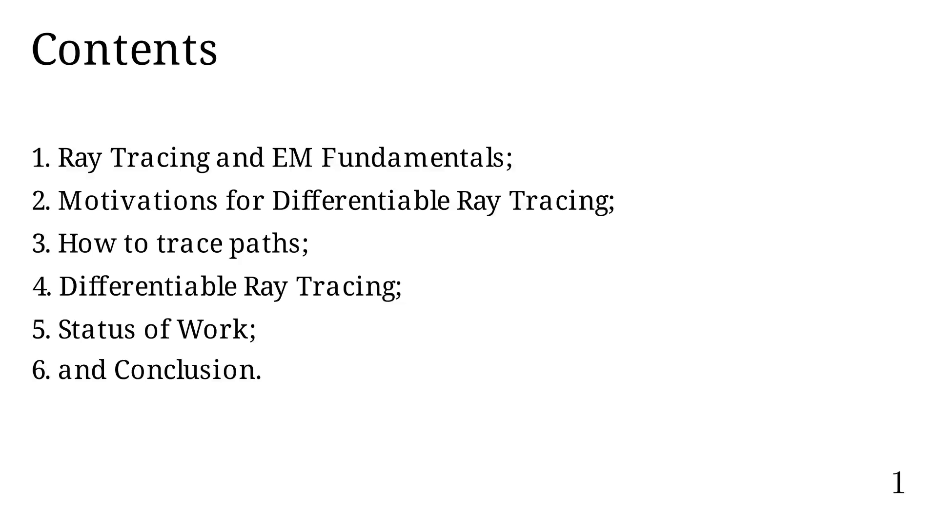
Notes:
RT and EM Fundamentals

Slide 15
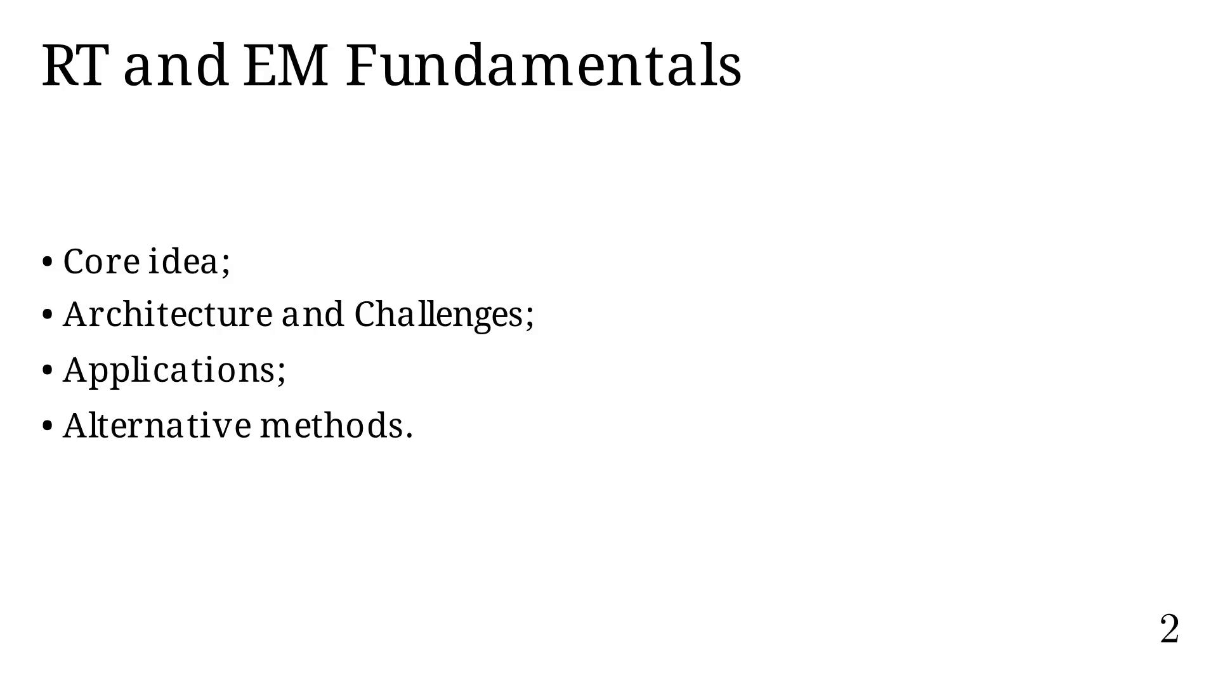
Notes:
We are interested in broadcasting waves from a BS

Slide 16
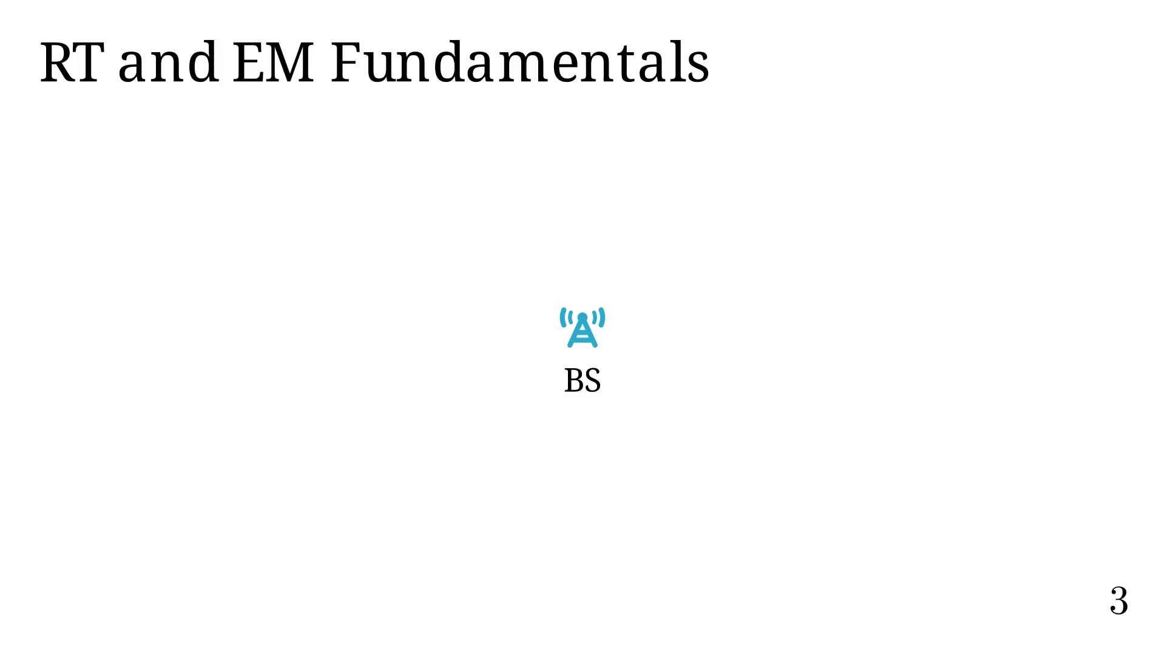
Notes:
In a simplified model, the BS emits waves isotropically.

Slide 17

Notes:
Using Huygen's principle, we can decompose a wave front into a
series of new wave sources.

Slide 18
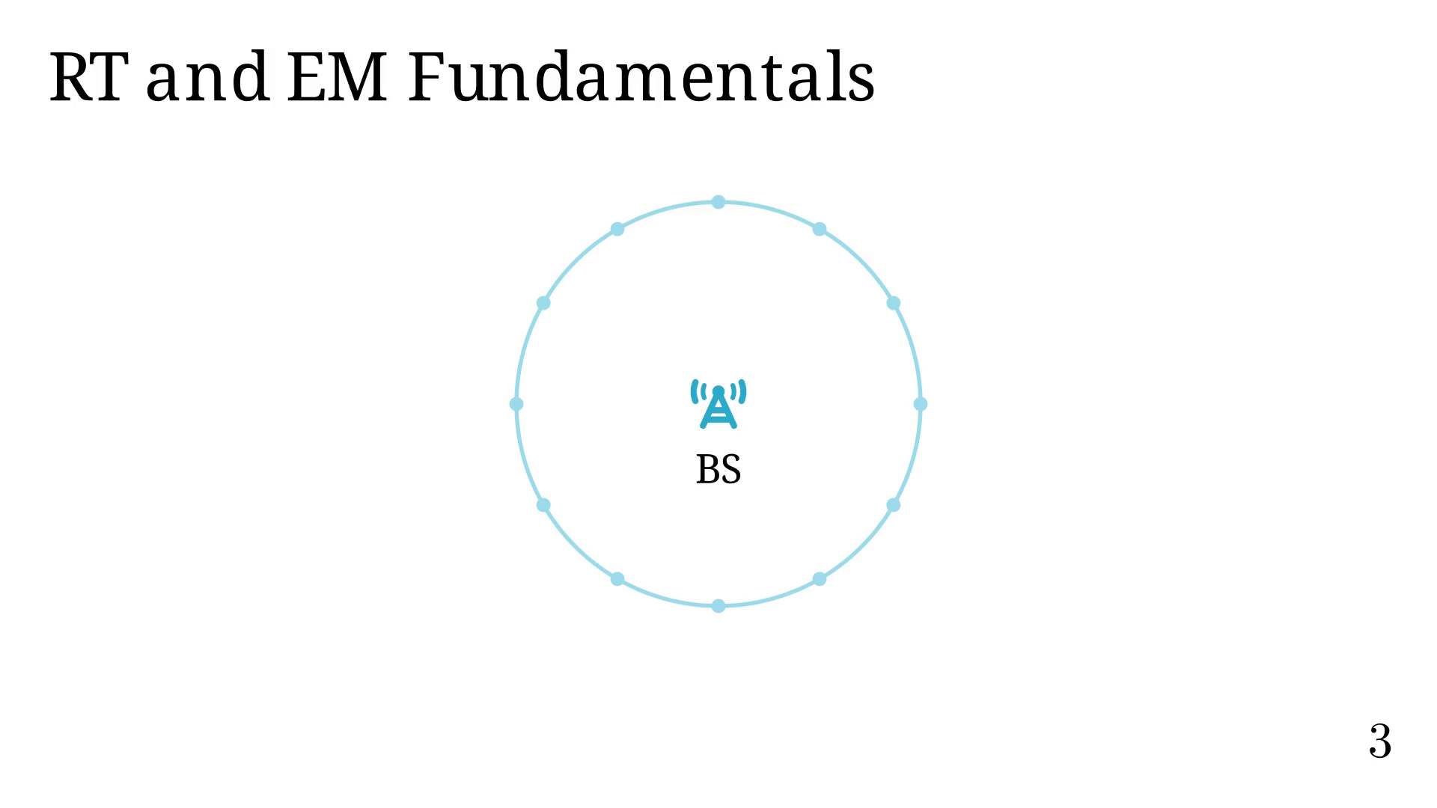
Notes:
Each source now broadcasts waves,
each with a fraction of the original energy

Slide 19


Slide 20
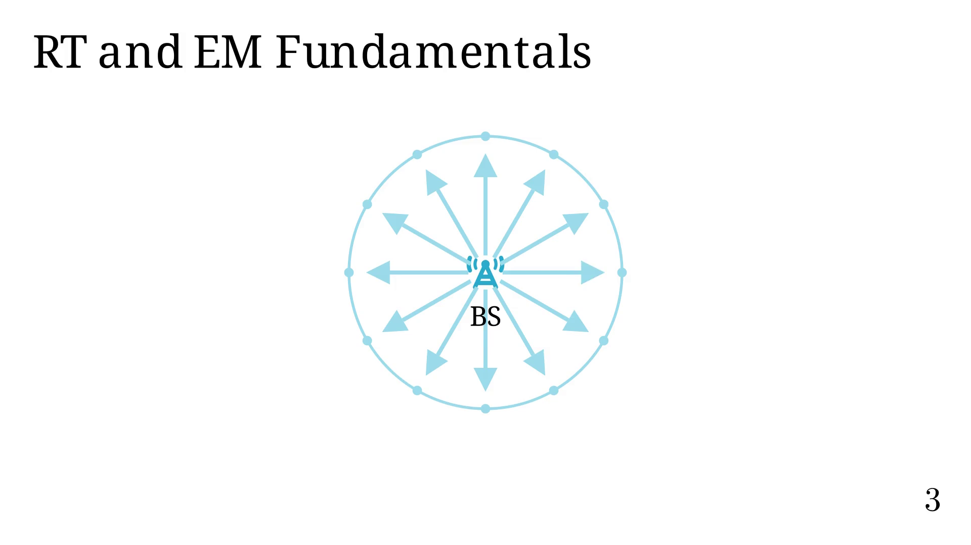
Notes:
RT considers each ray path individually.

Slide 21
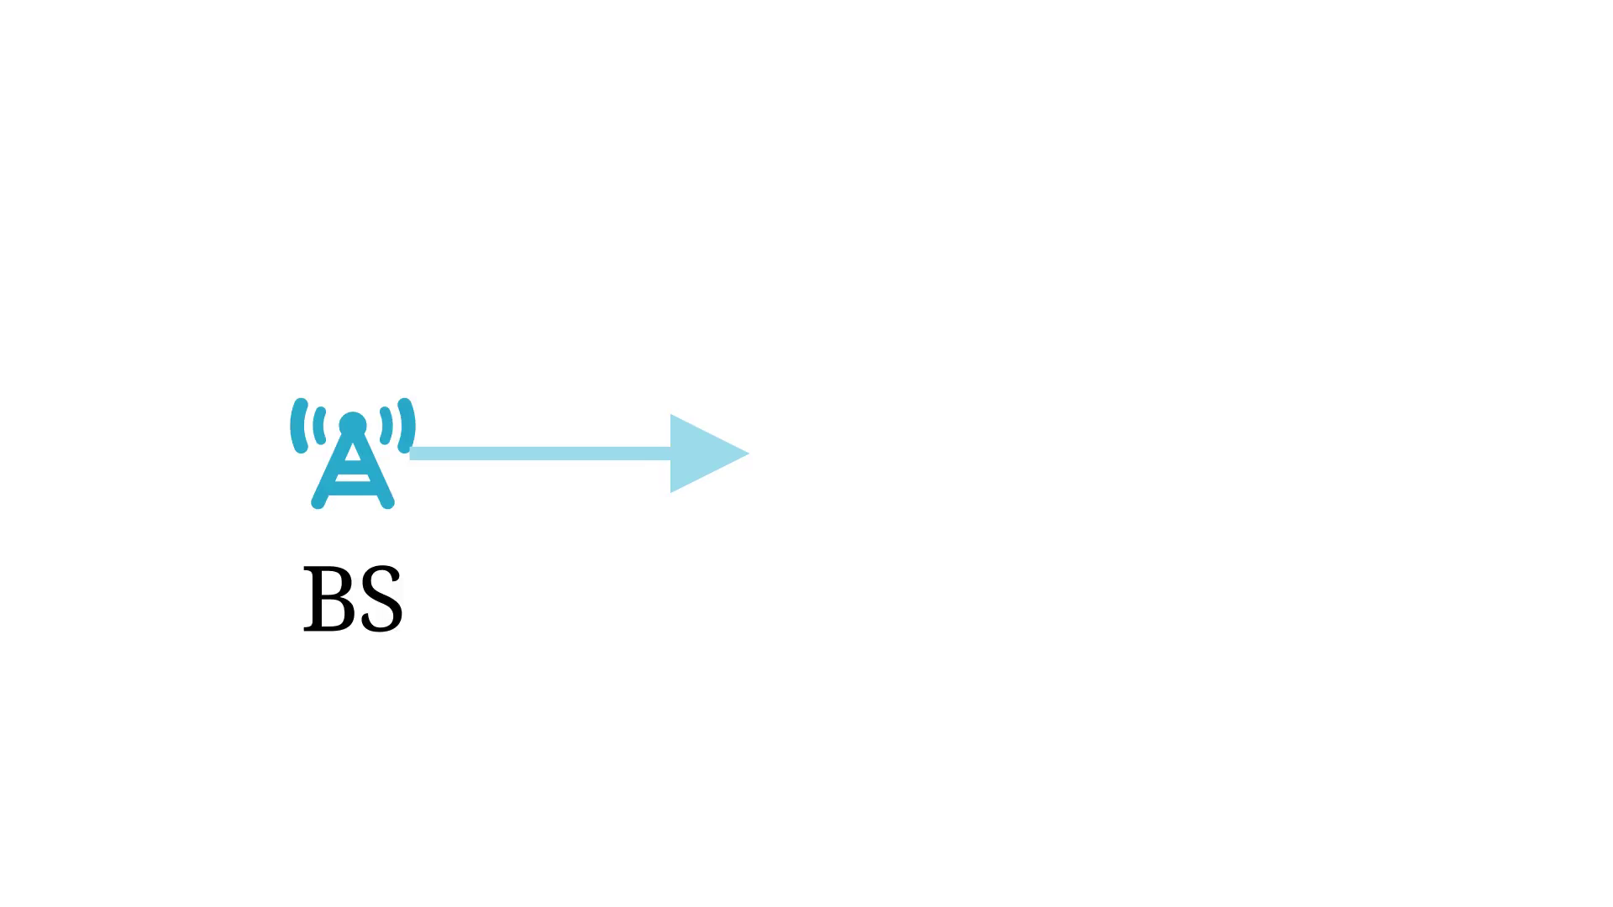
Notes:
In a constant speed space, ray paths are linear.

Slide 22
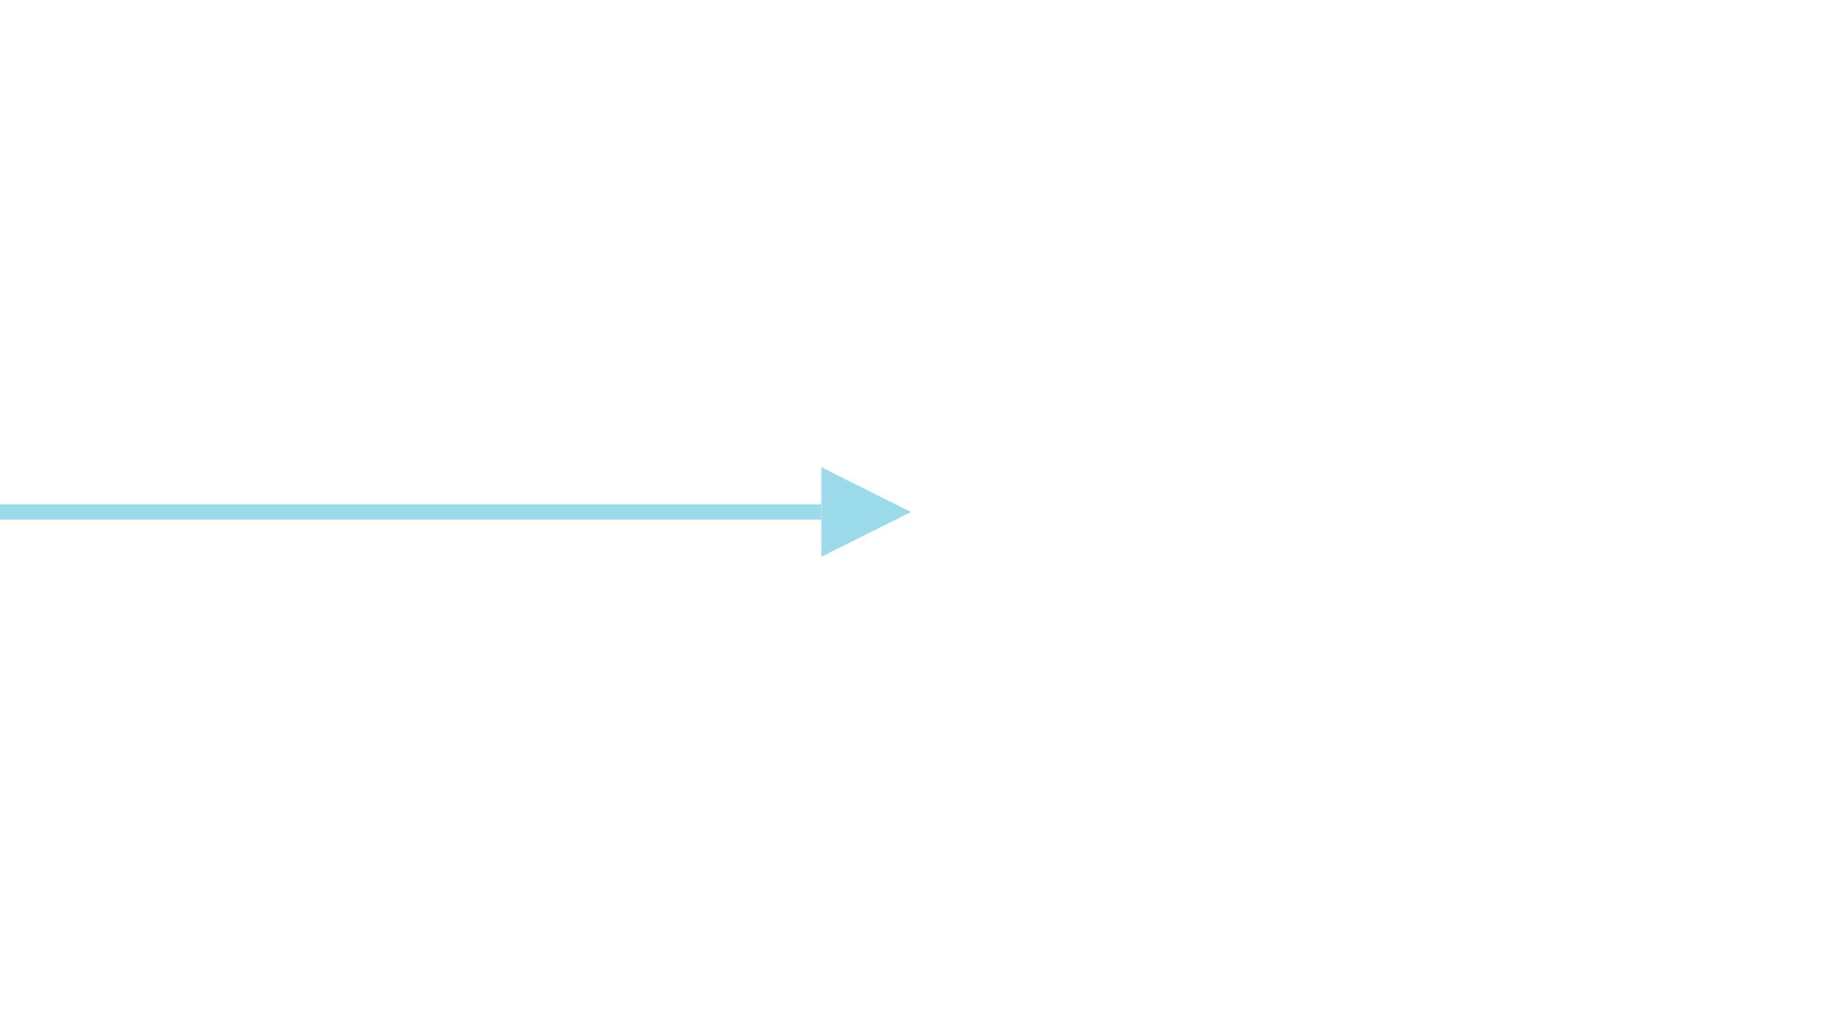
Notes:
Maybe, we reach some obstacle.

Slide 23
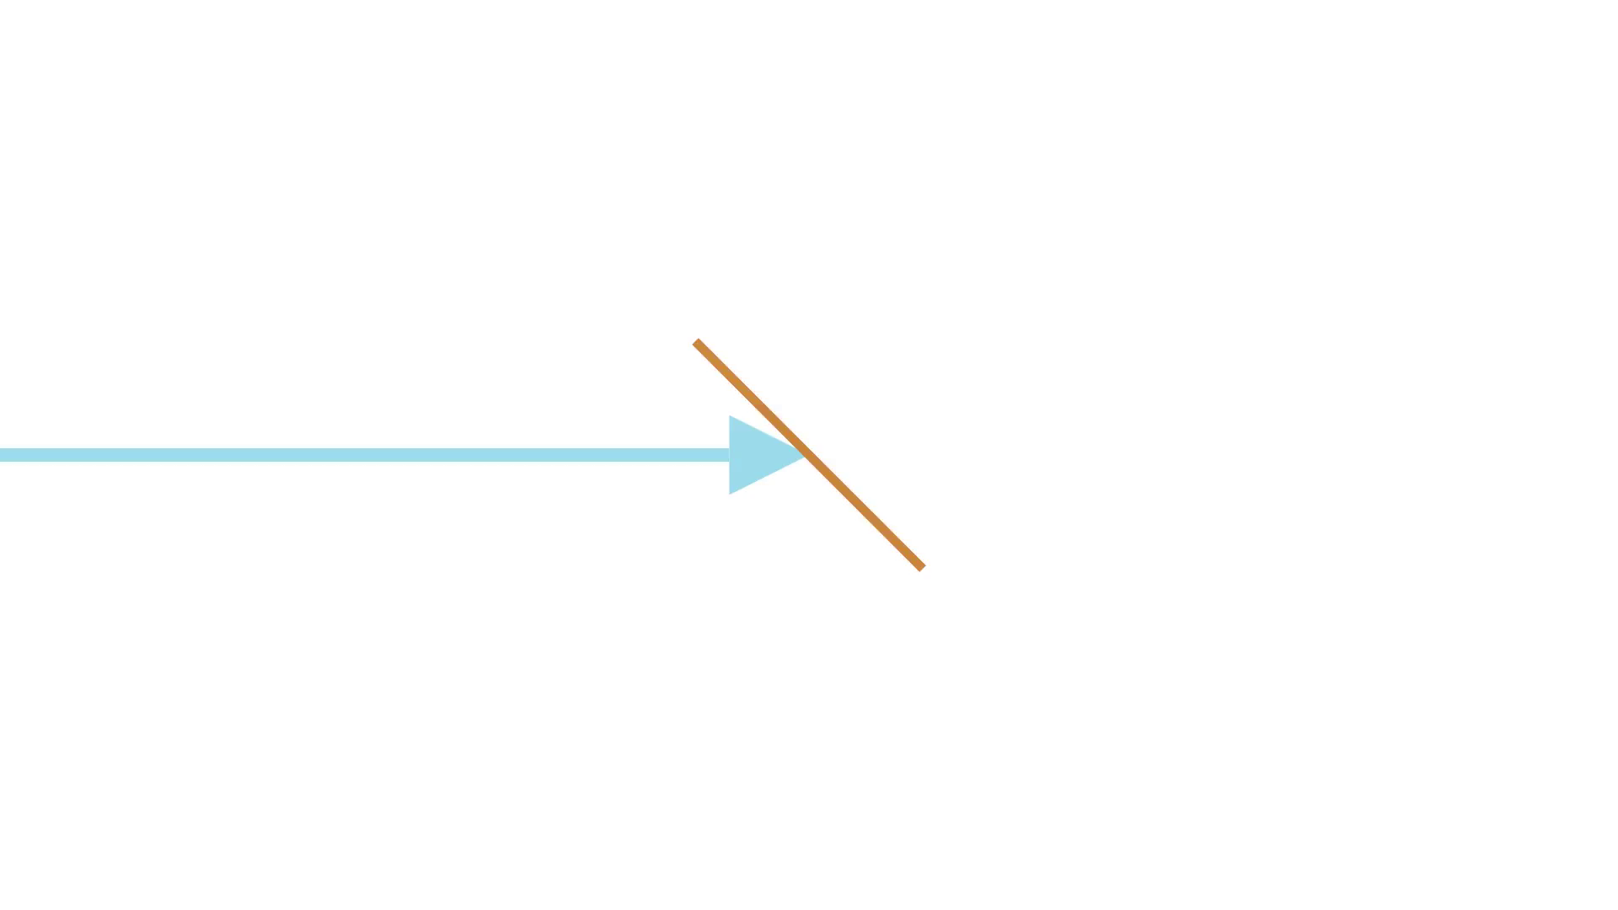
Notes:
If we decide to apply reflection.

Slide 24
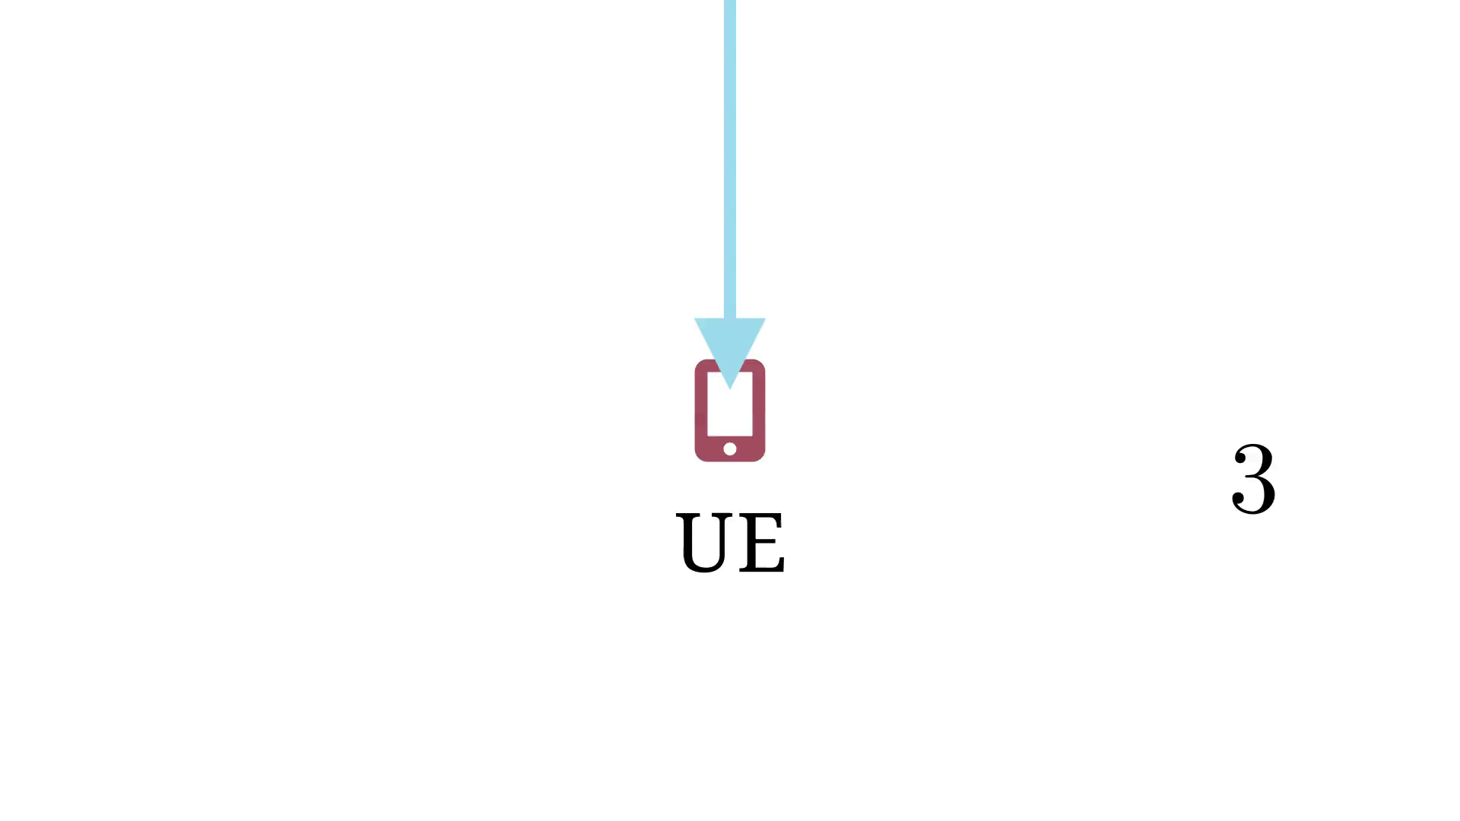
Notes:
We can do that for very complex scenes and many paths.

Slide 25
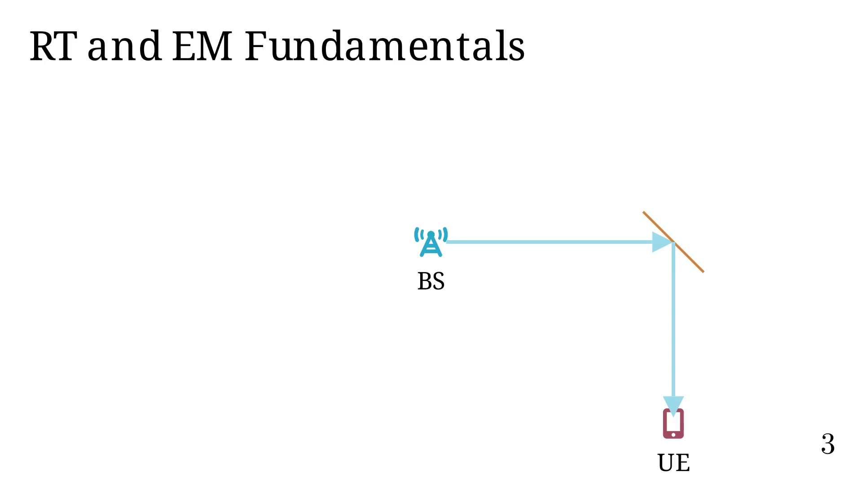
Notes:
Example of tracing paths in 3D Urban scene.

Slide 26
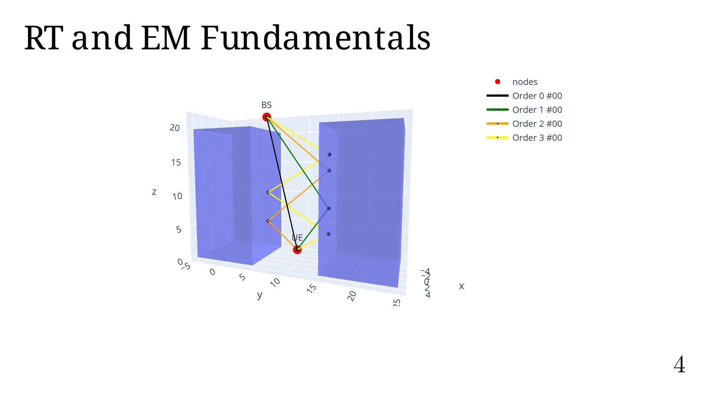
Notes:
In Radio-propa., we have two quantities: E and B.
Both are vectors (3D) and complex.
But, only 2 components are needed!! Hence 2x2 dyadic matrices.
The most used quantify if E, from which we usually determine
the received power (plane wave, lossless medium).

Slide 27
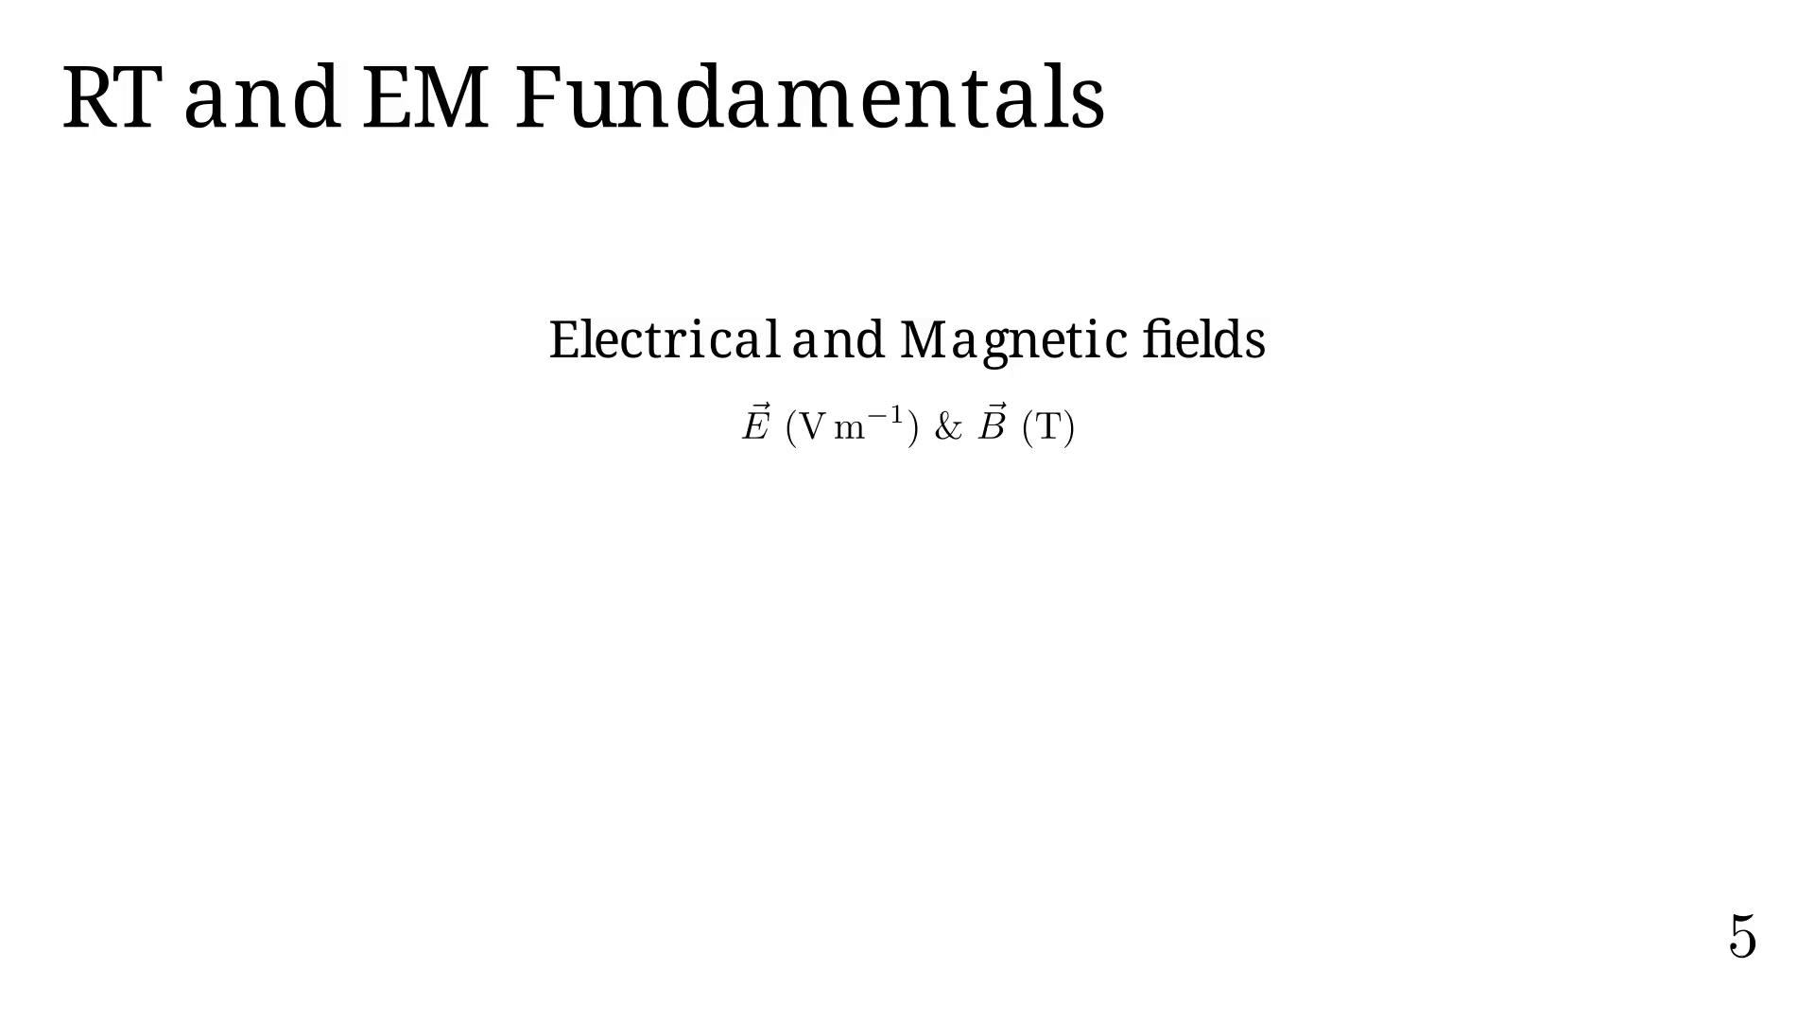
Notes:
By superposition, E (and B) can be computed by summing the contribution
from each path.

Slide 28
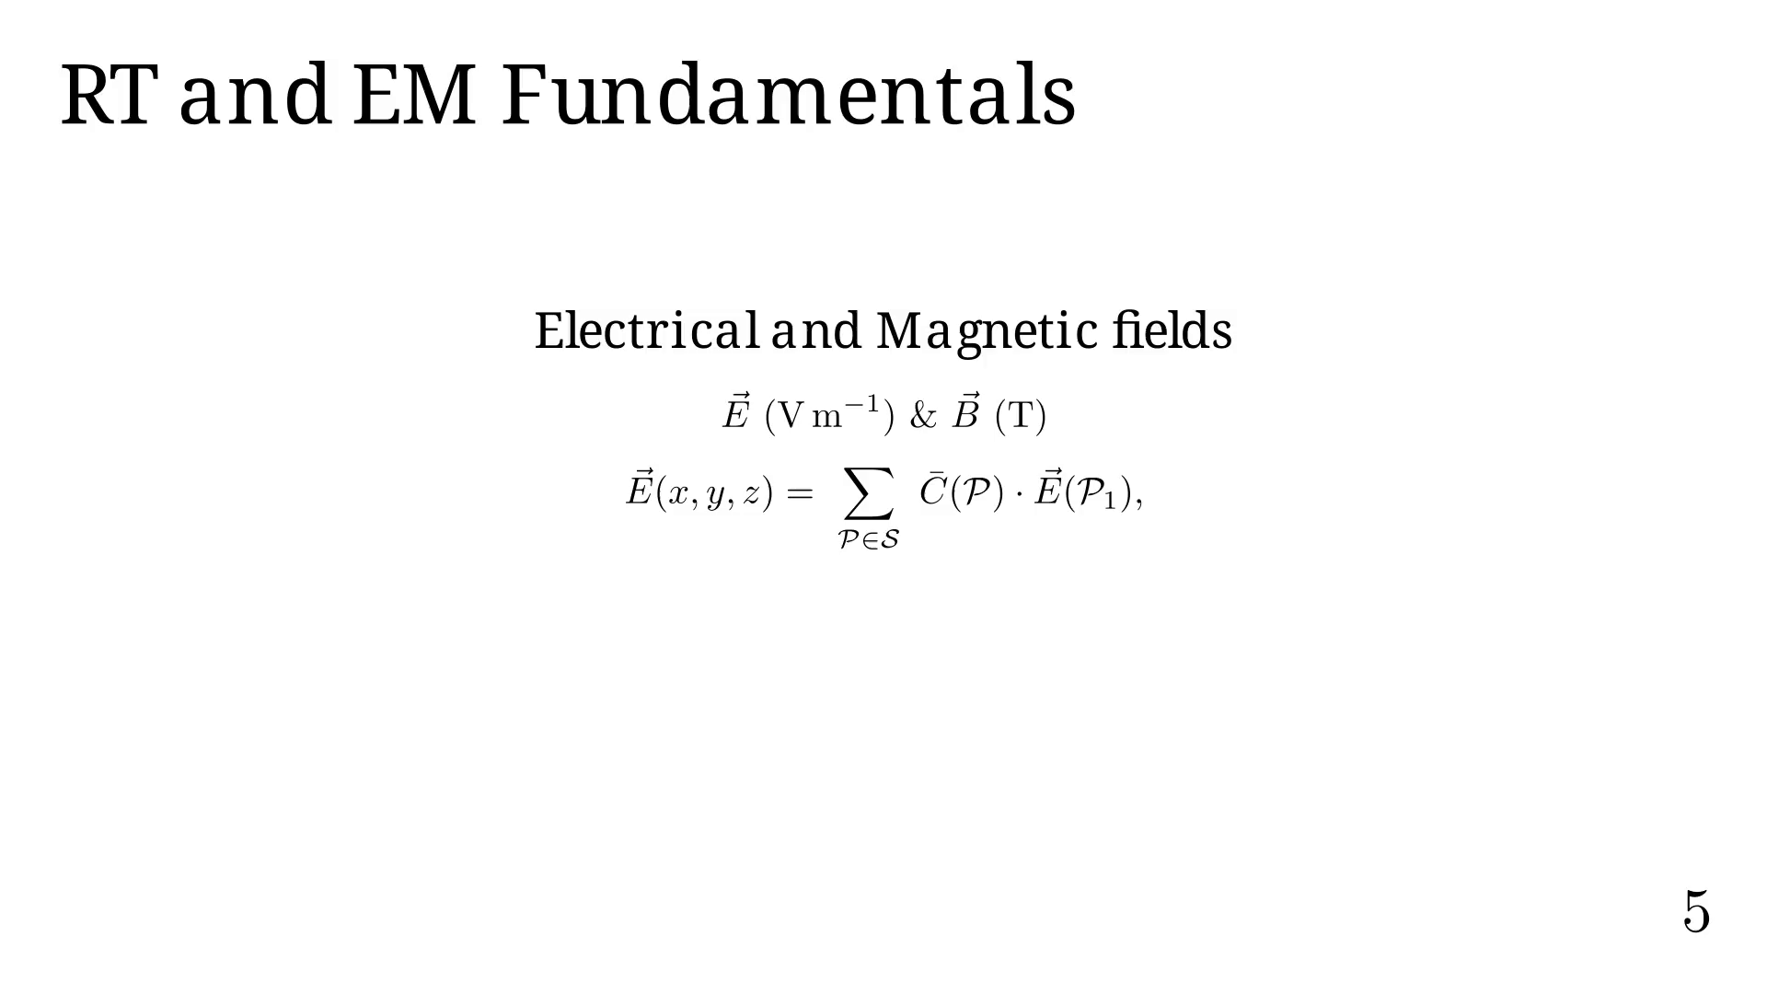
Notes:
Where C accounts for:
- D the dyadic coefficients for polarization;
- alpha the path attenuation;
- and the path delay.

Slide 29
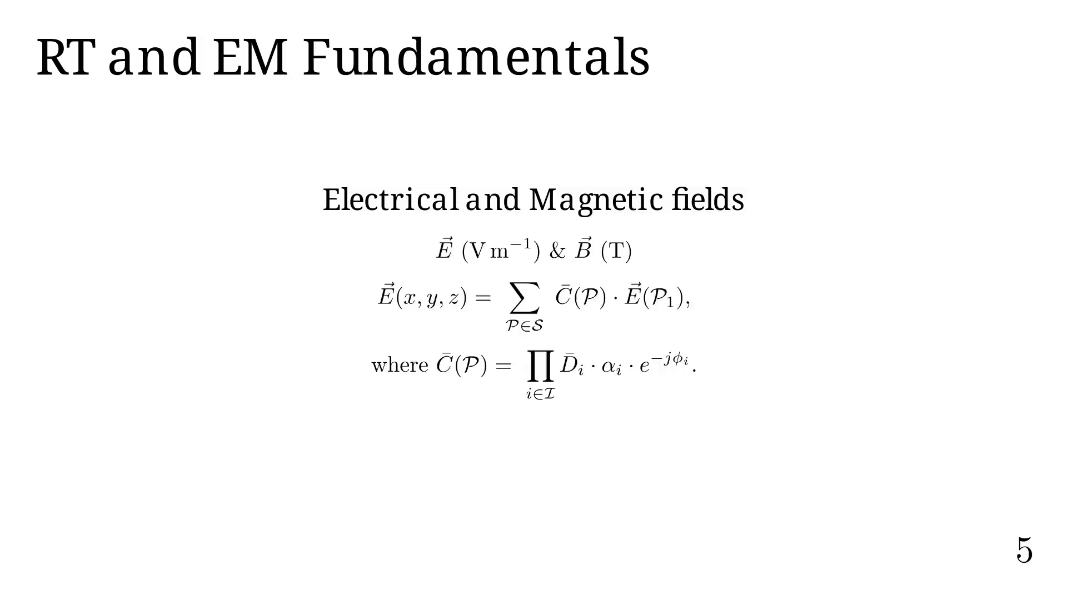
Notes:
The basic RT pipeline is as follows.

Slide 30
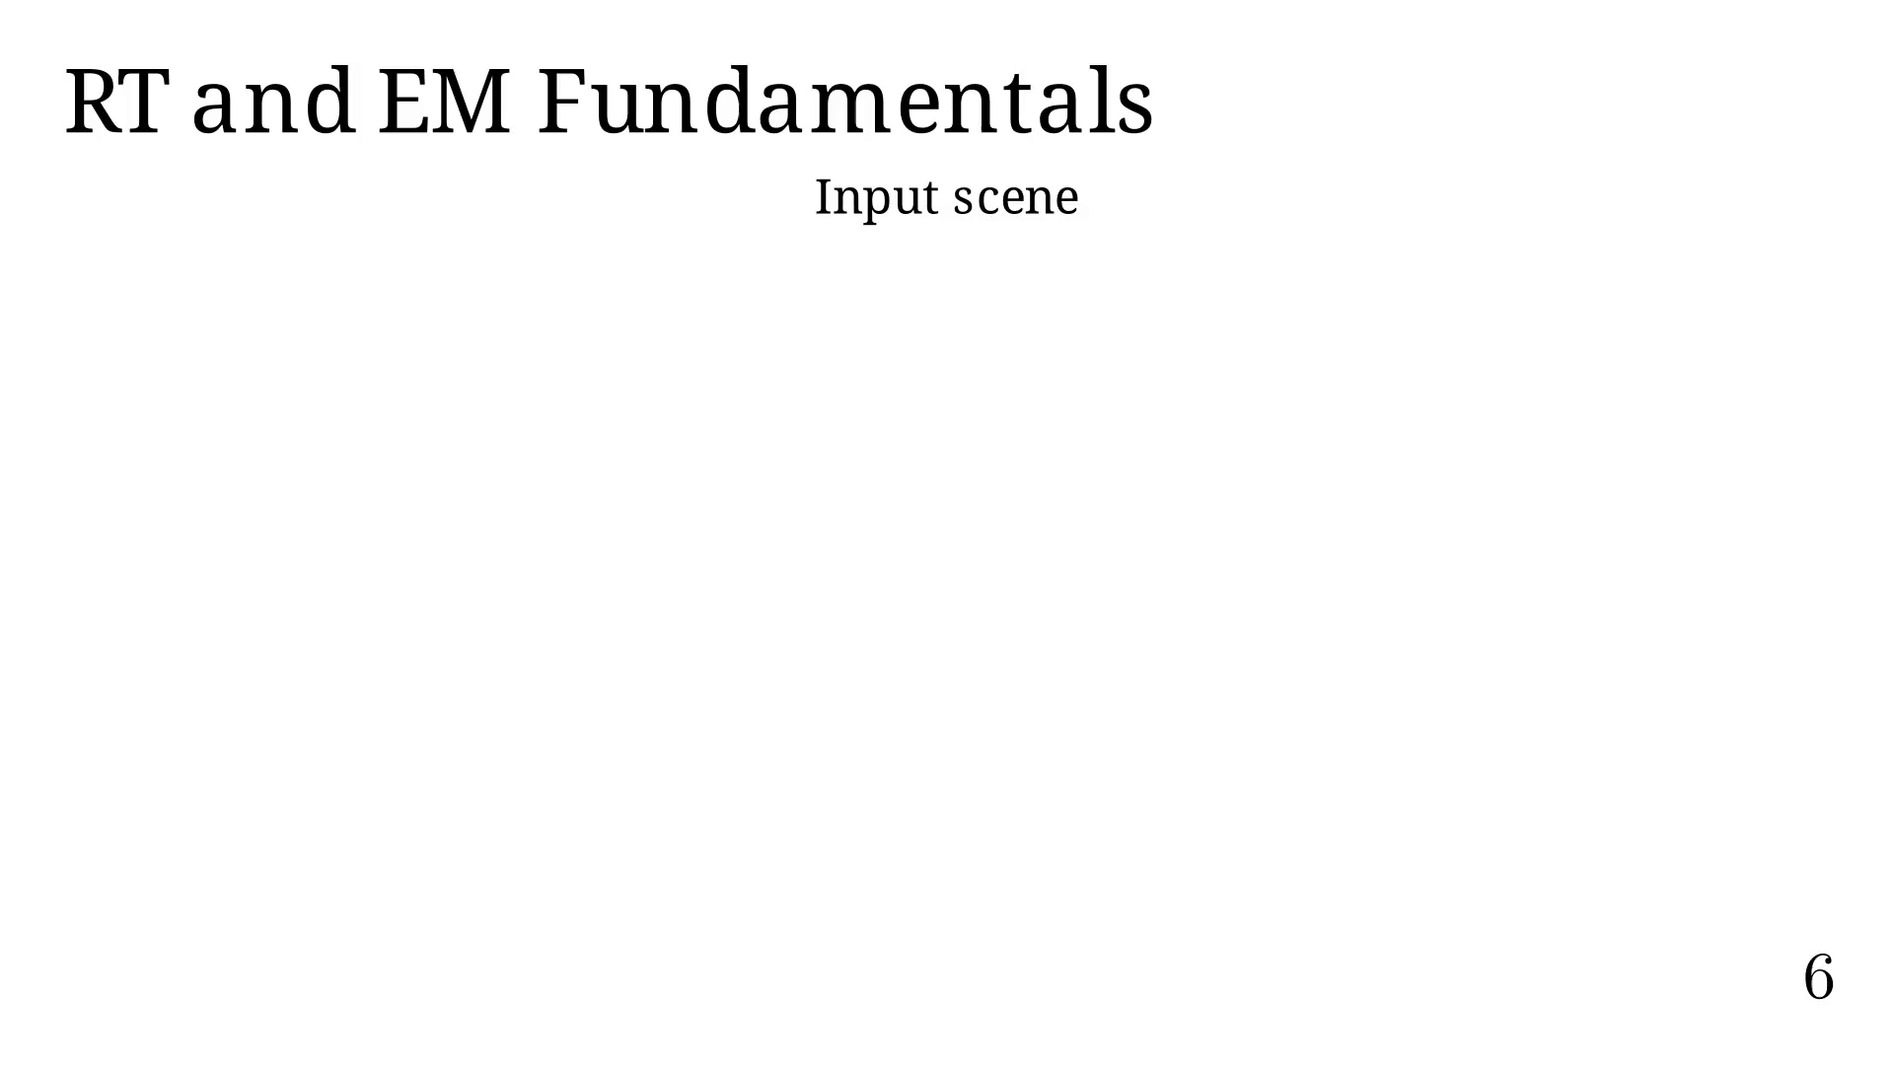
Notes:
Next pipeline step.

Slide 31
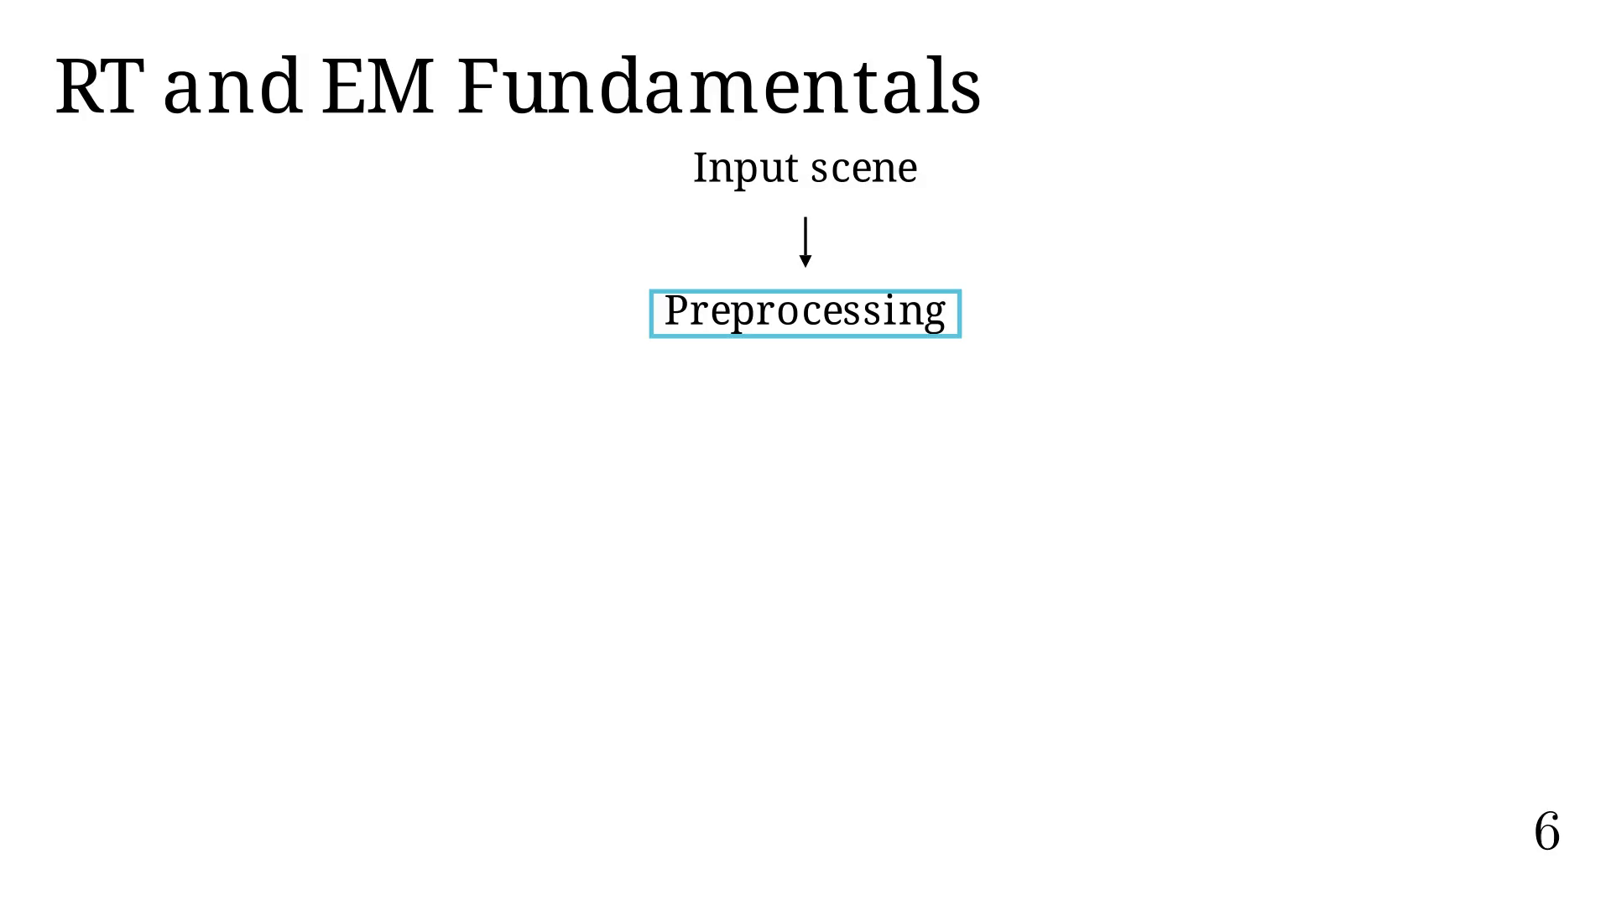
Notes:
Next pipeline step.

Slide 32
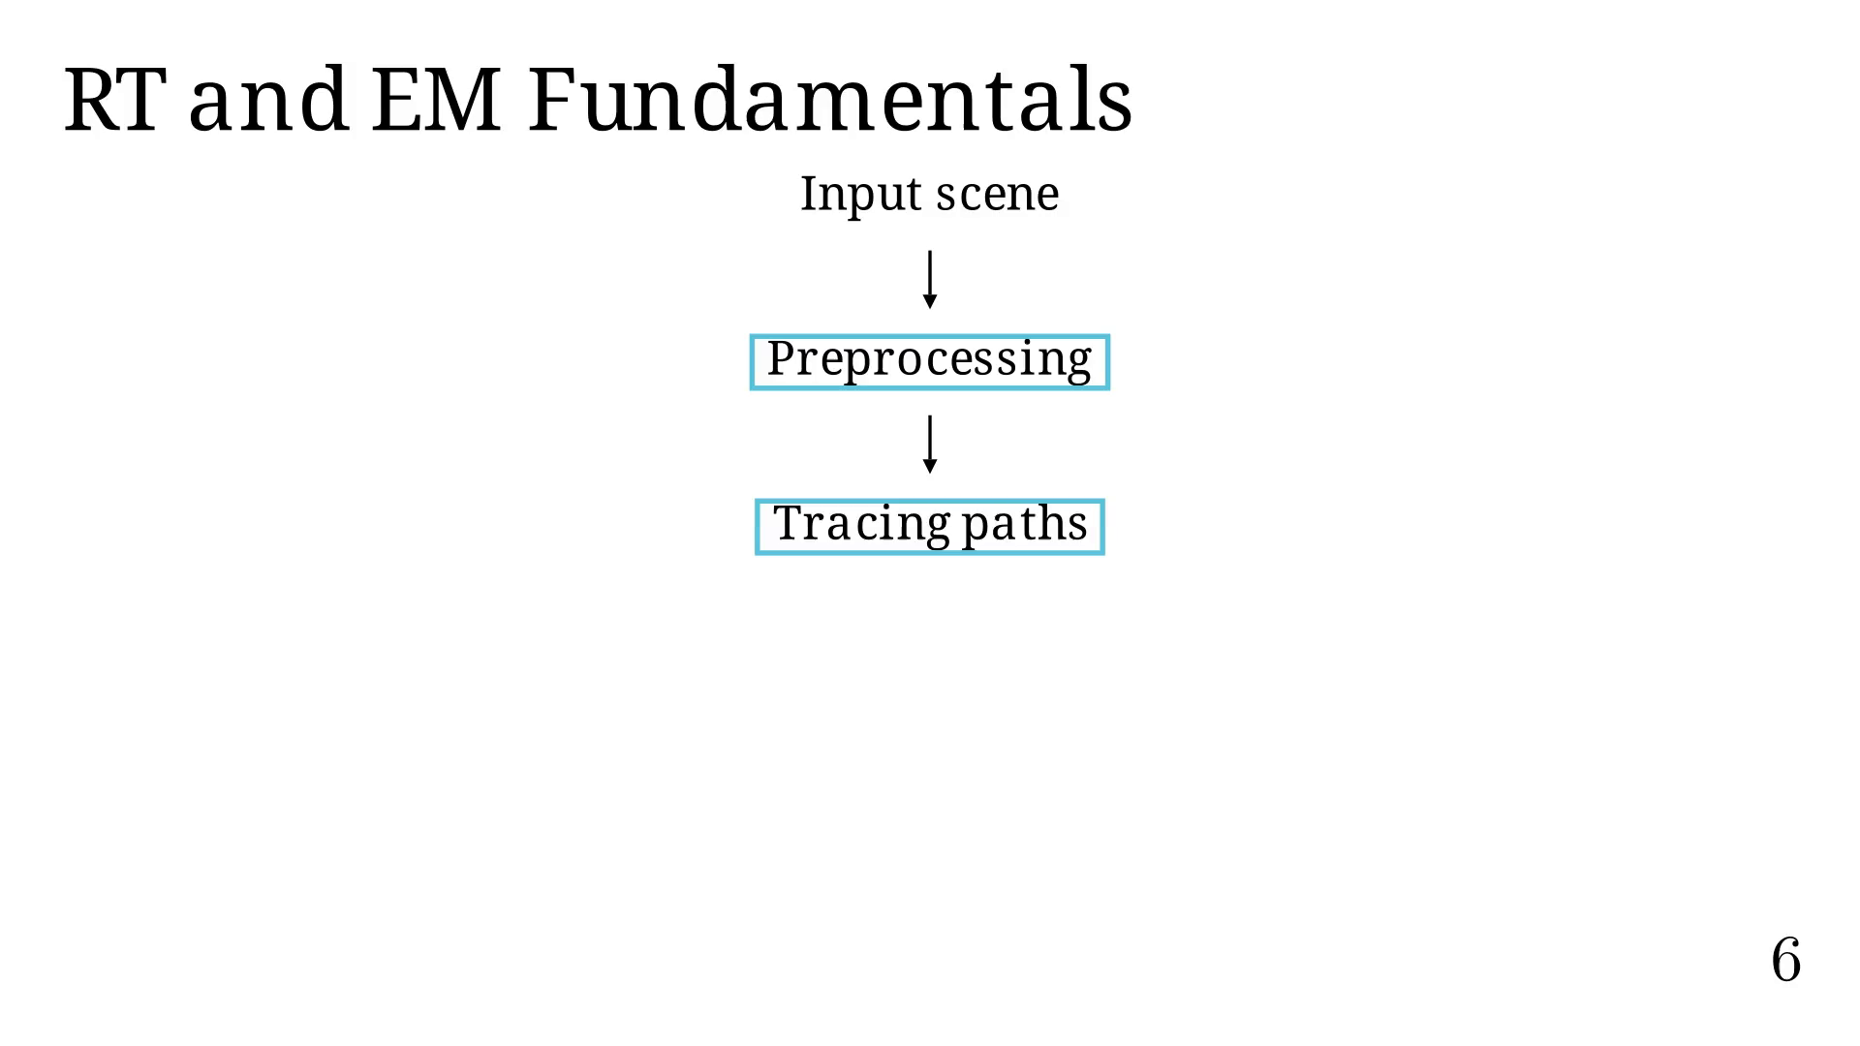
Notes:
Next pipeline step.

Slide 33
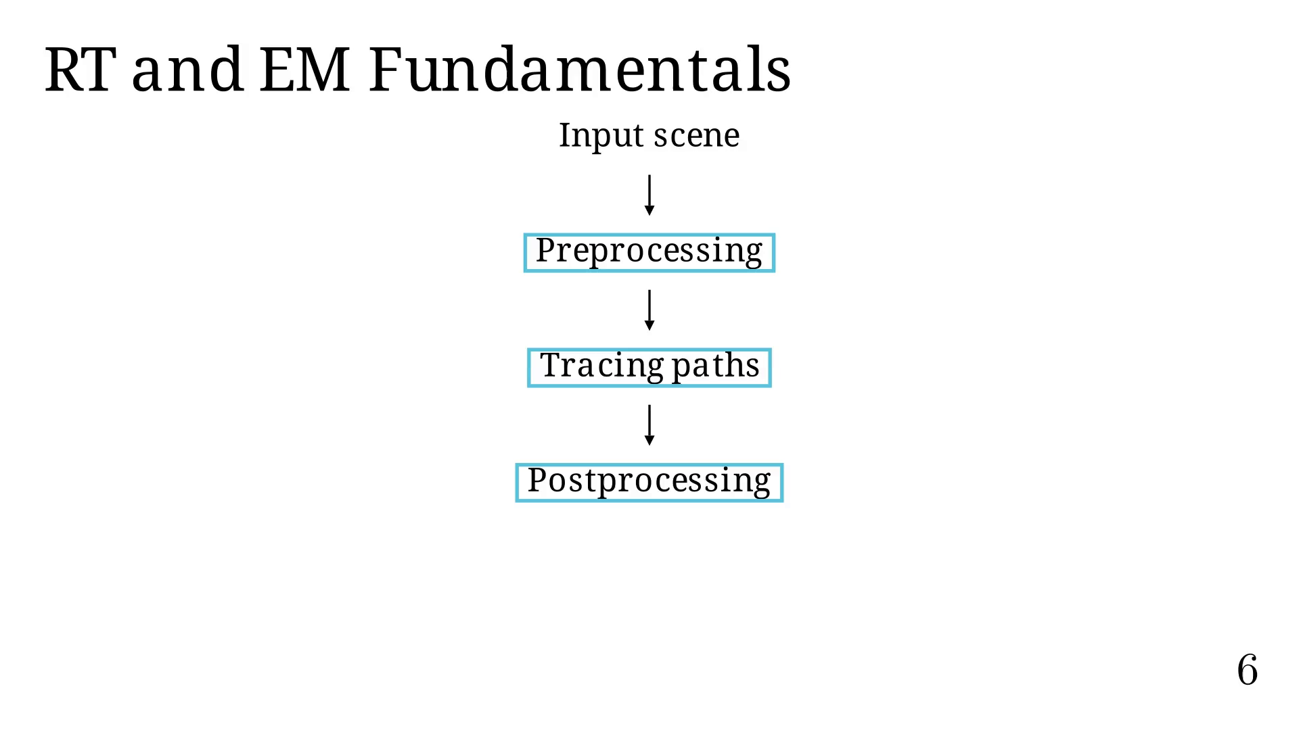
Notes:
Next pipeline step.

Slide 34
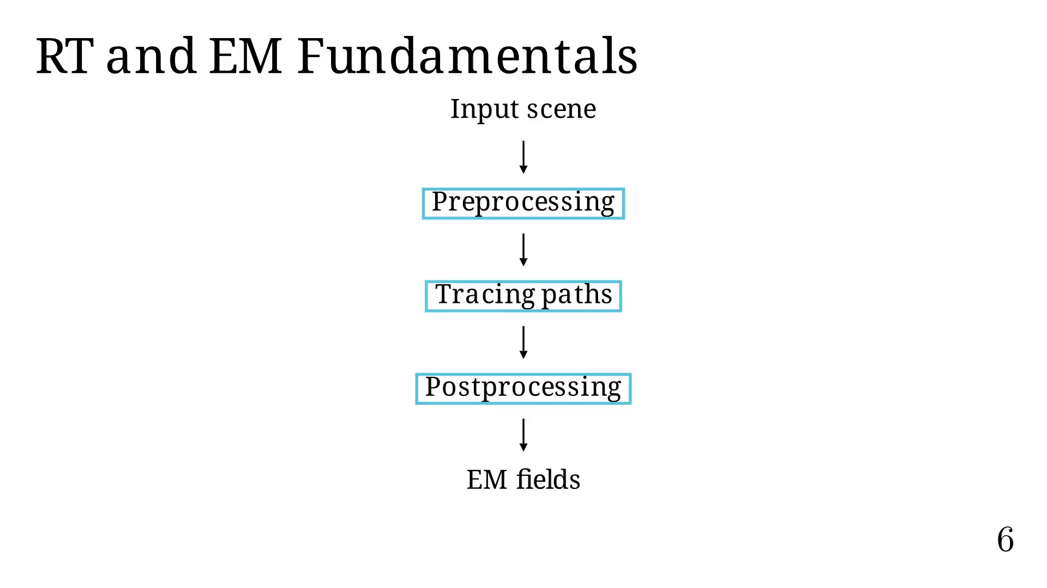
Notes:
RT example in a city (Munich).

Slide 35
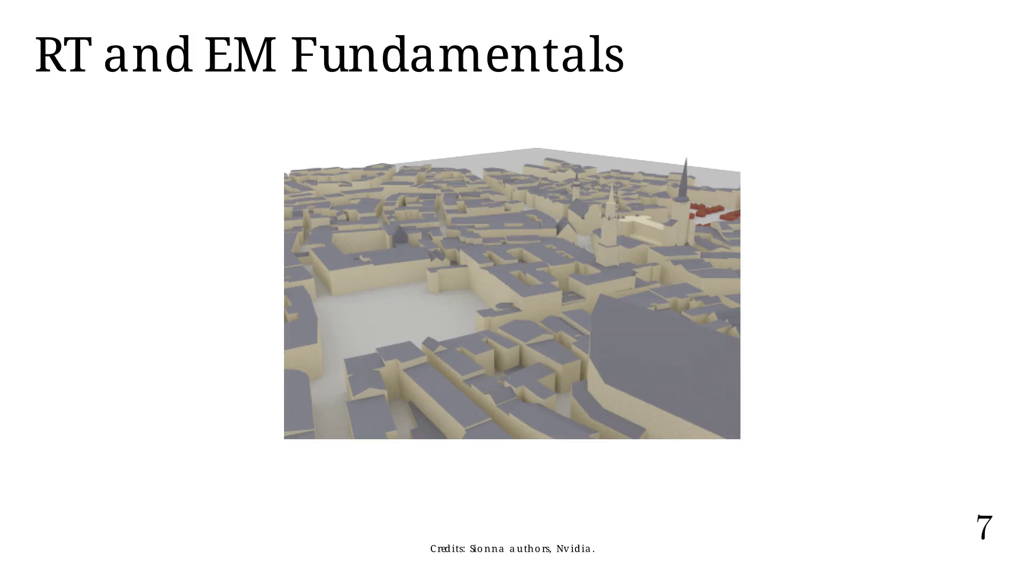
Notes:
Then we perform RT.

Slide 36
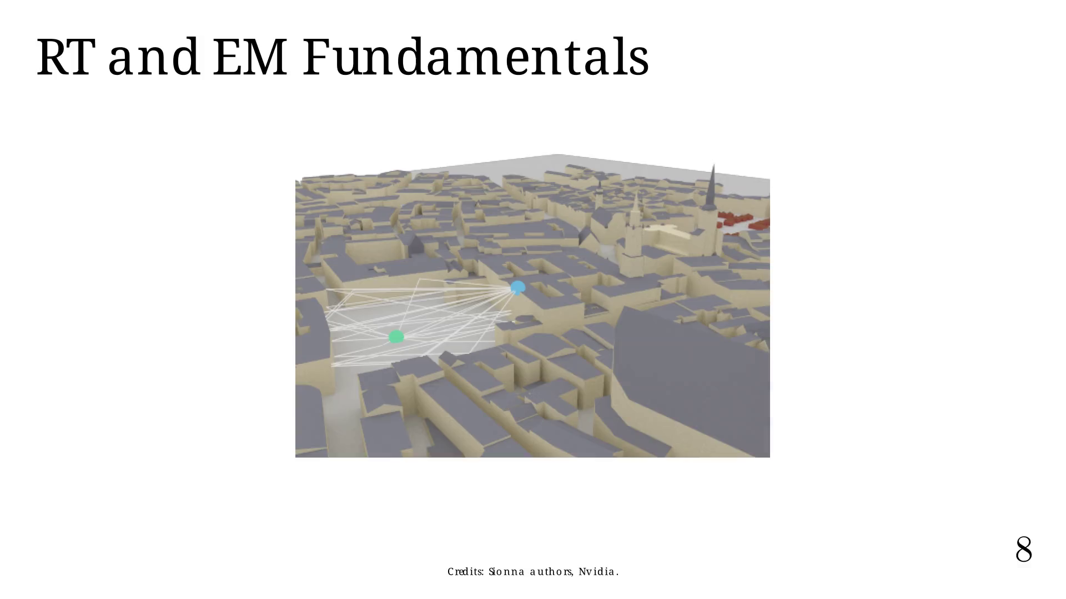
Notes:
From paths, we can compute the coverage map.

Slide 37
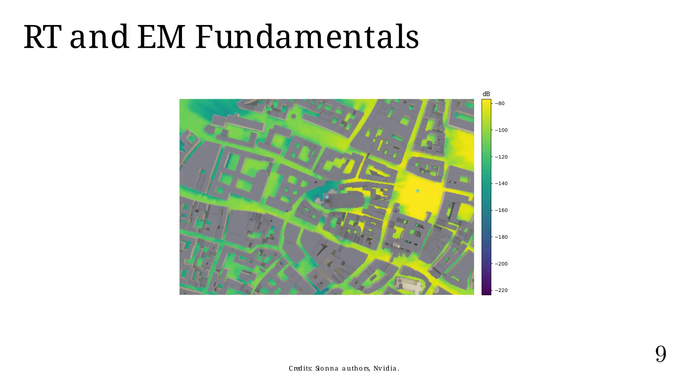
Notes:
Or reuse paths to compute the CIR.

Slide 38
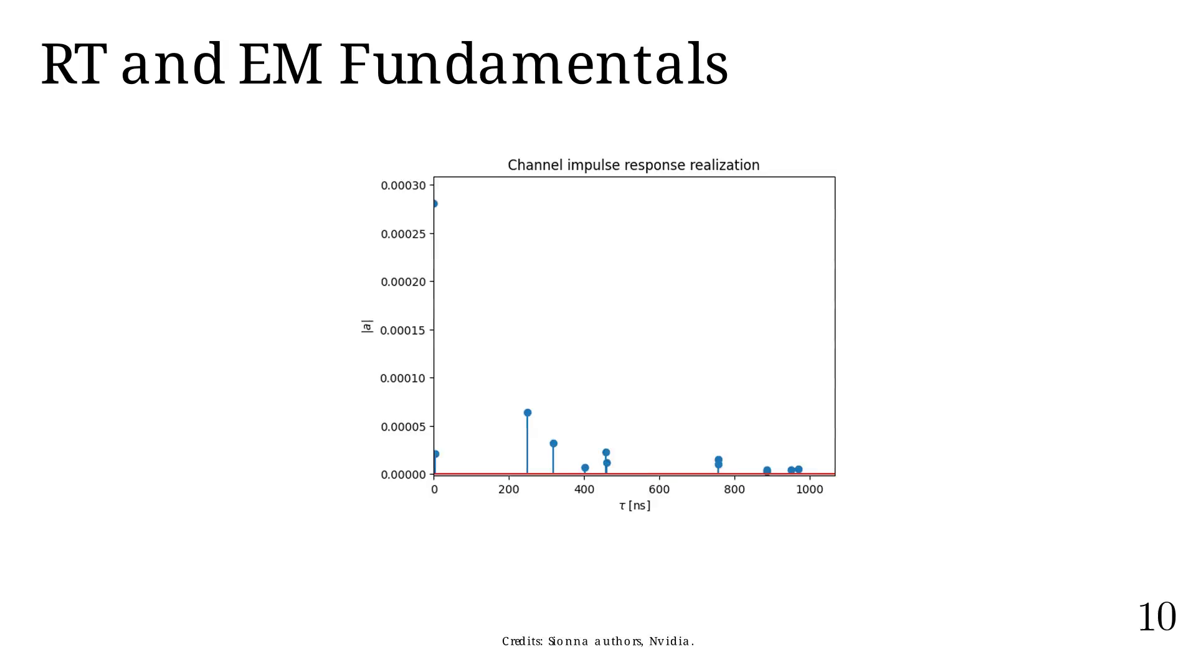
Notes:
RT's implementation presents many challenges,
mainly the exponential number of paths we can test.

Slide 39
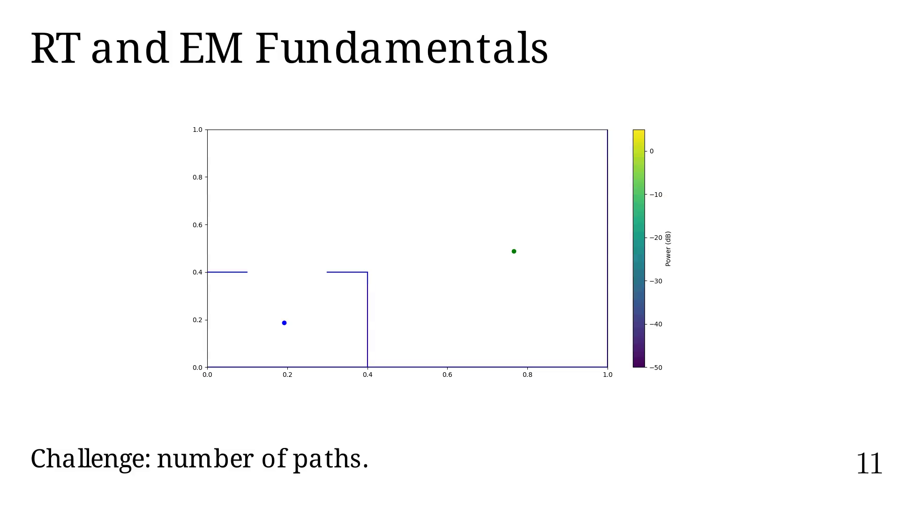
Notes:
Order = 0

Slide 40
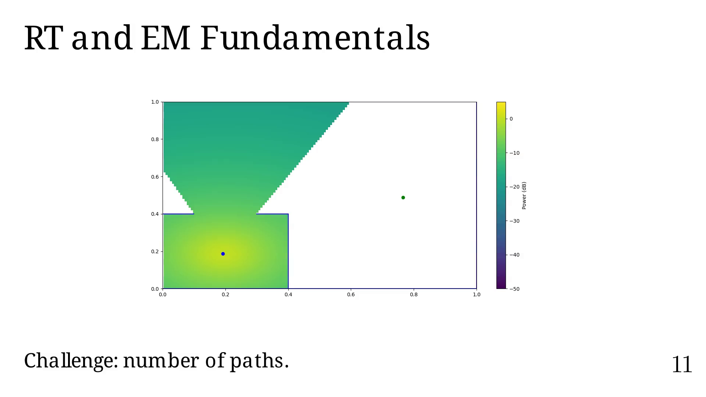
Notes:
Order = 1

Slide 41
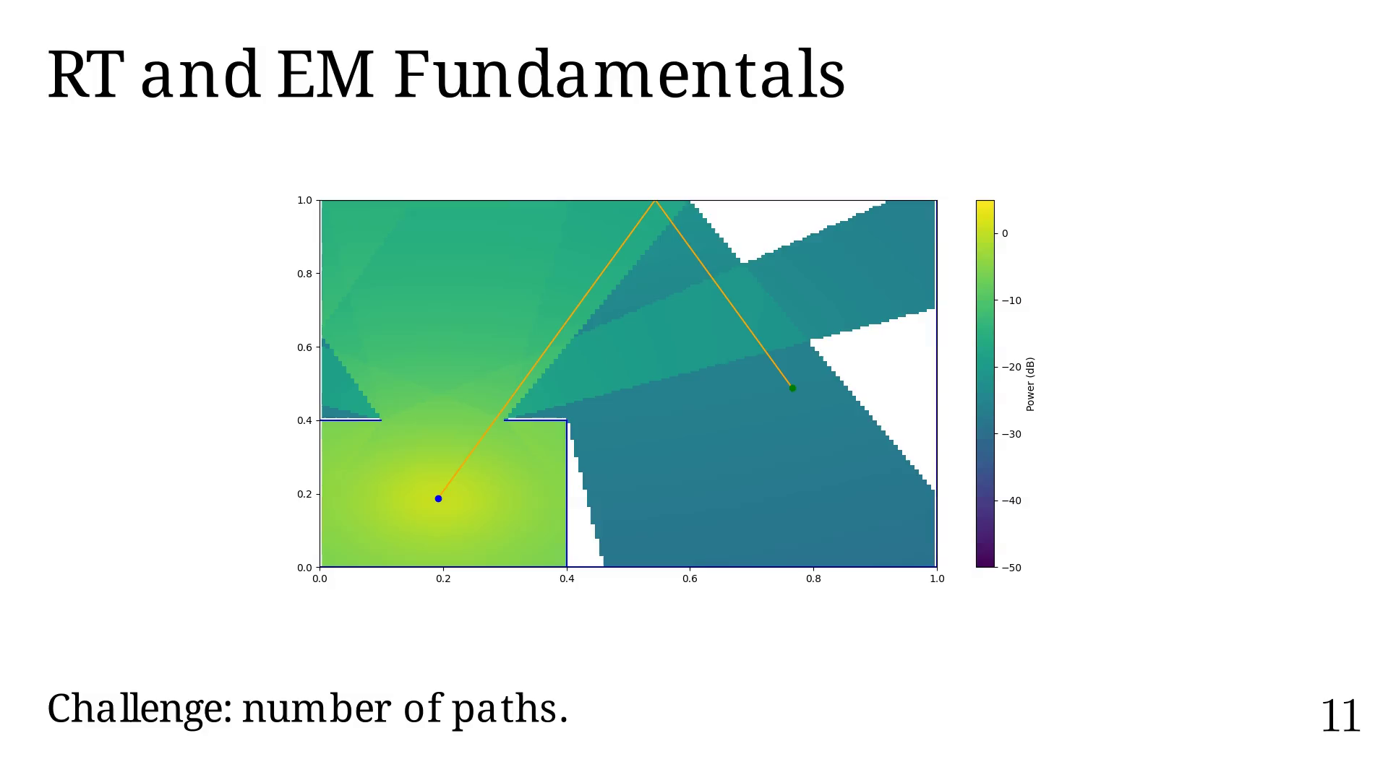
Notes:
Order = 2

Slide 42
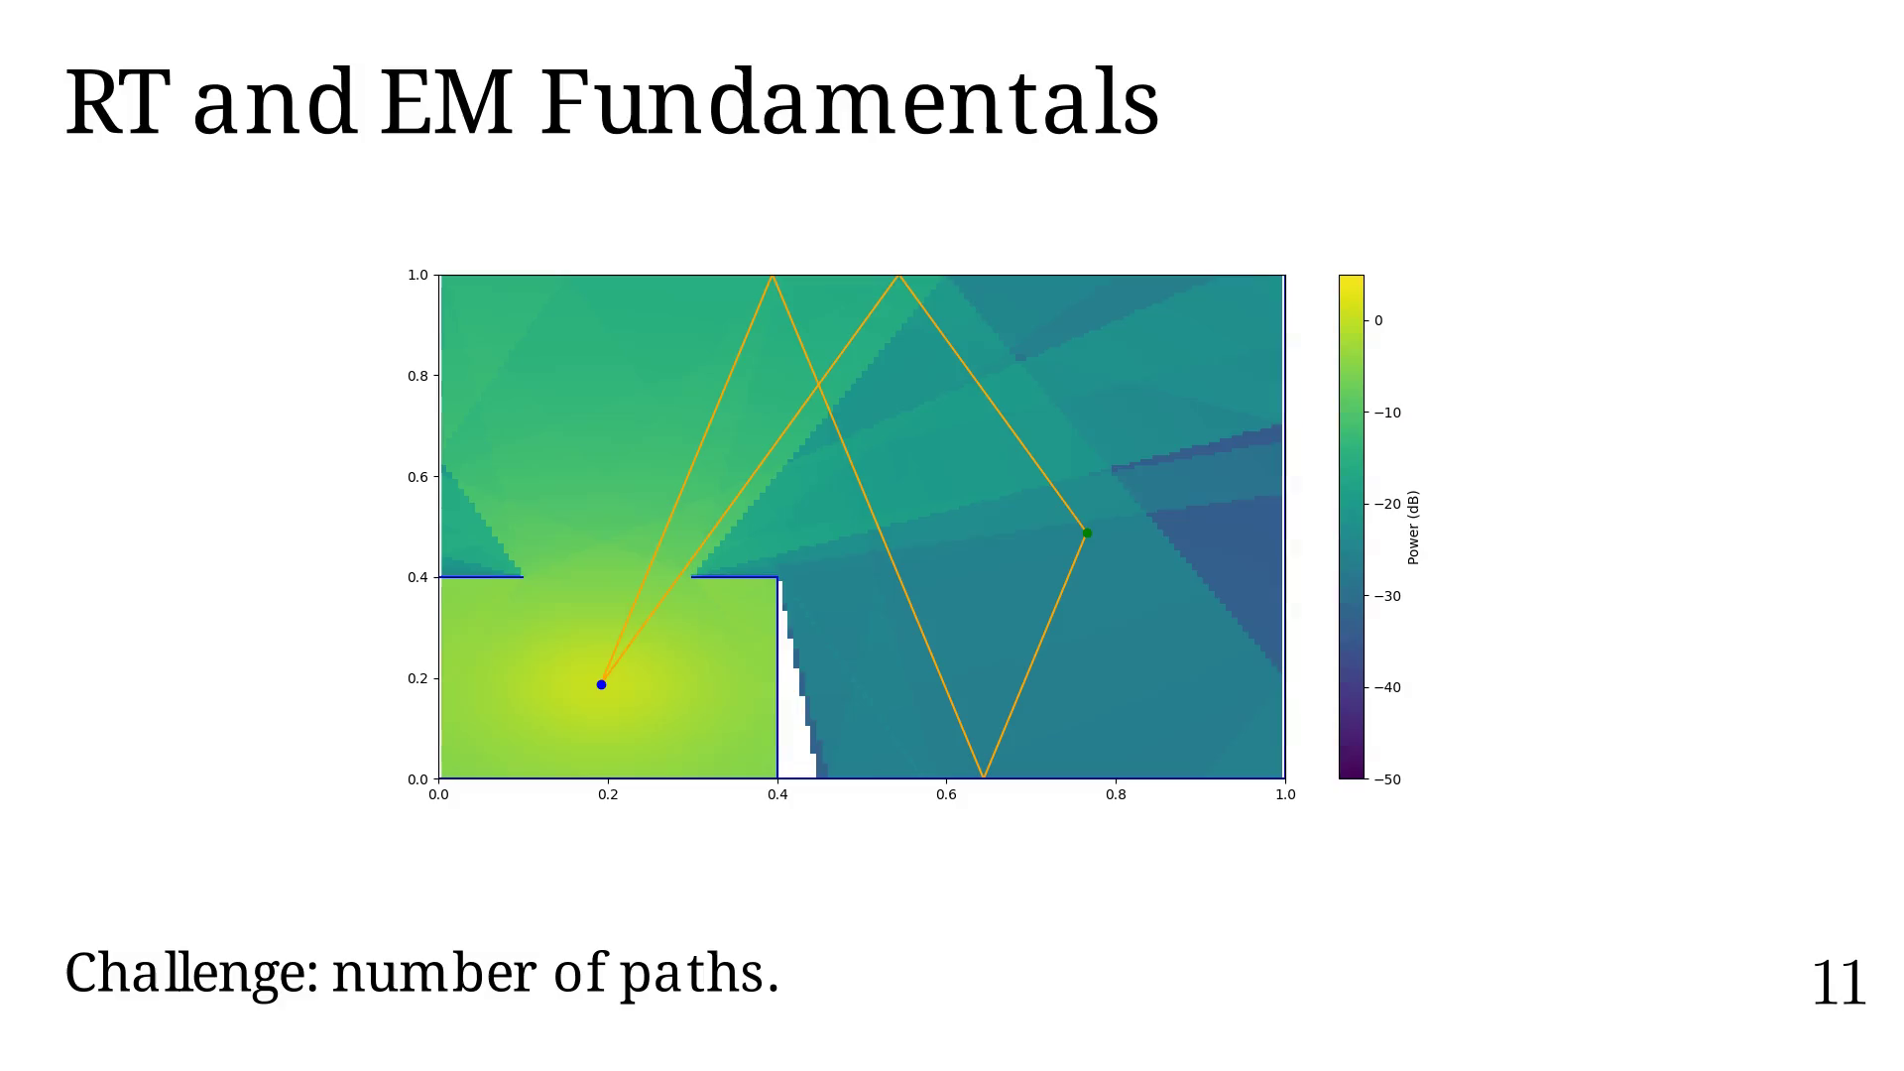
Notes:
Order = 3

Slide 43
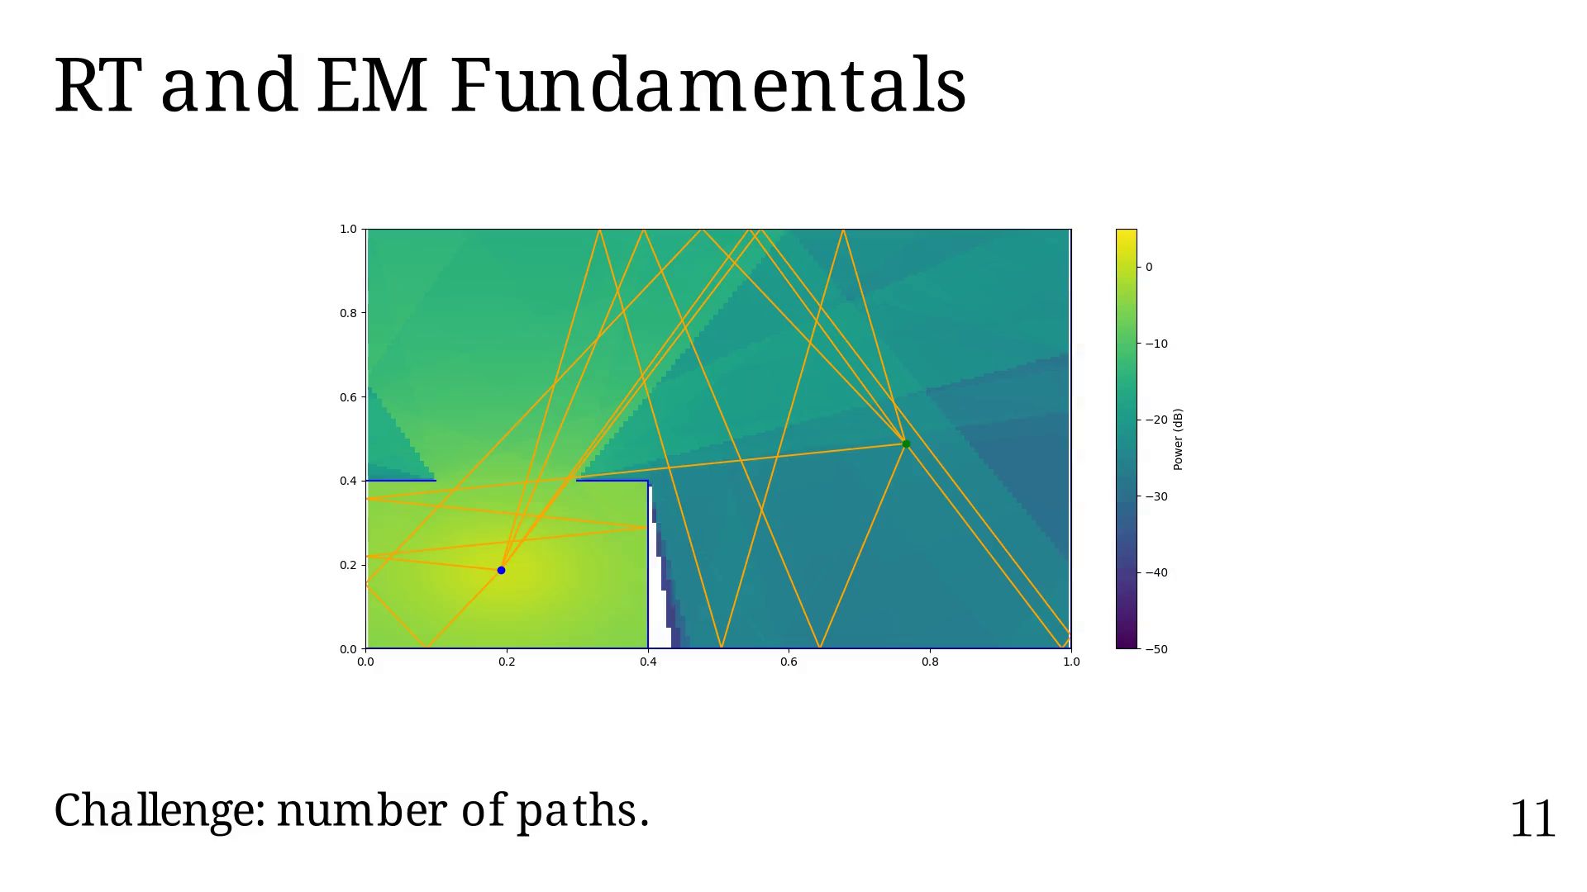
Notes:
Order = 4

Slide 44
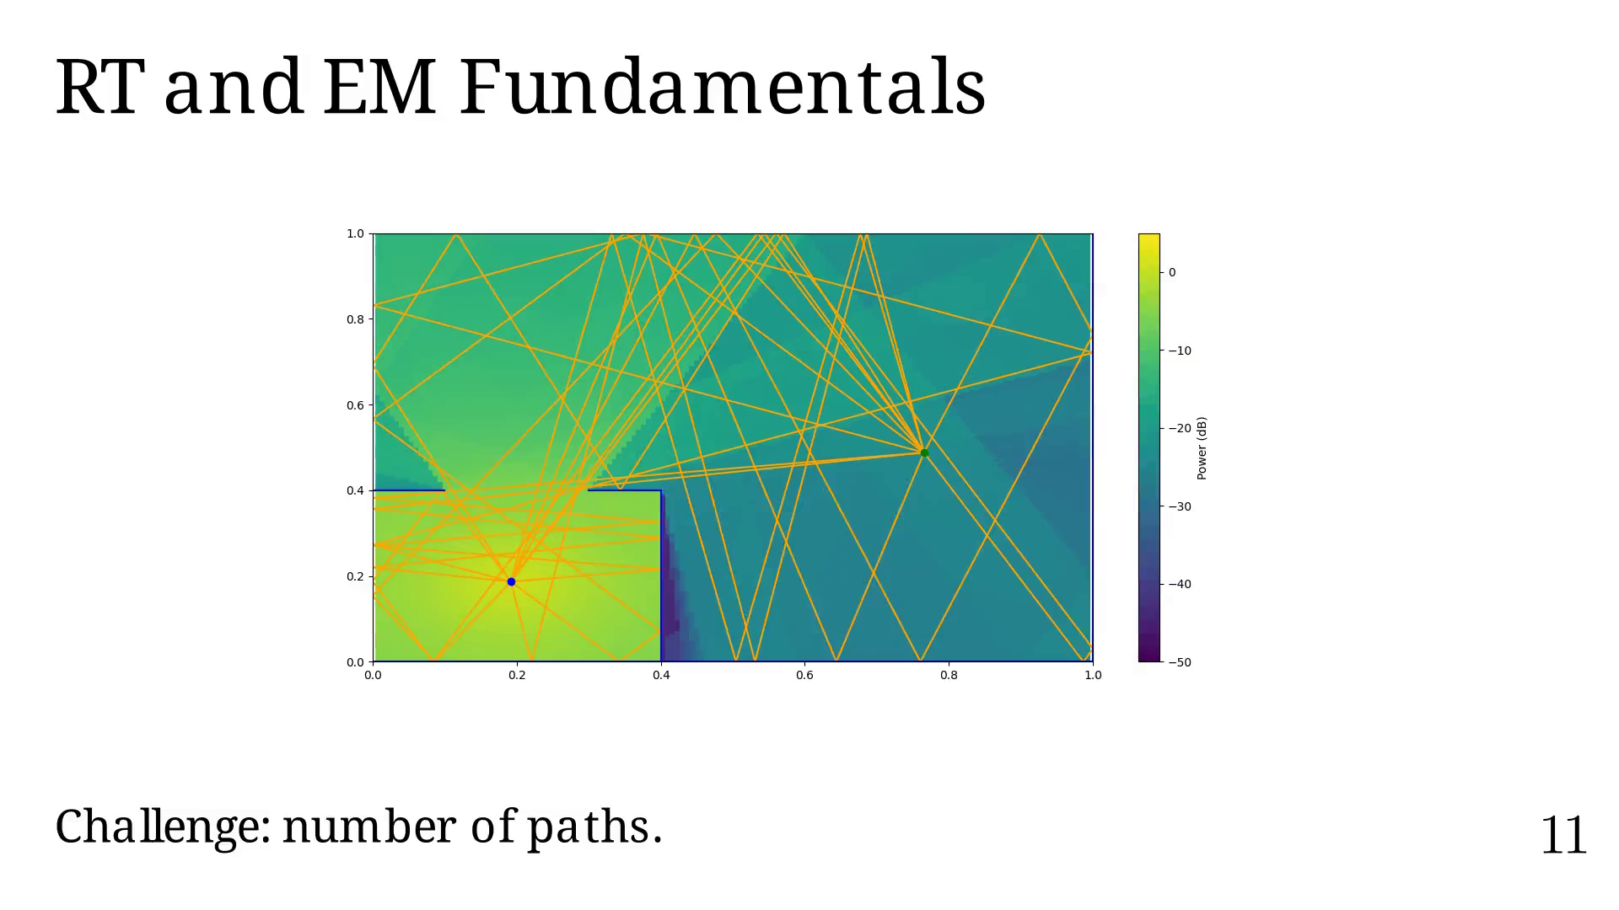
Notes:
Another challenge is the total path coverage versus
the order and types of interaction considered.

Slide 45
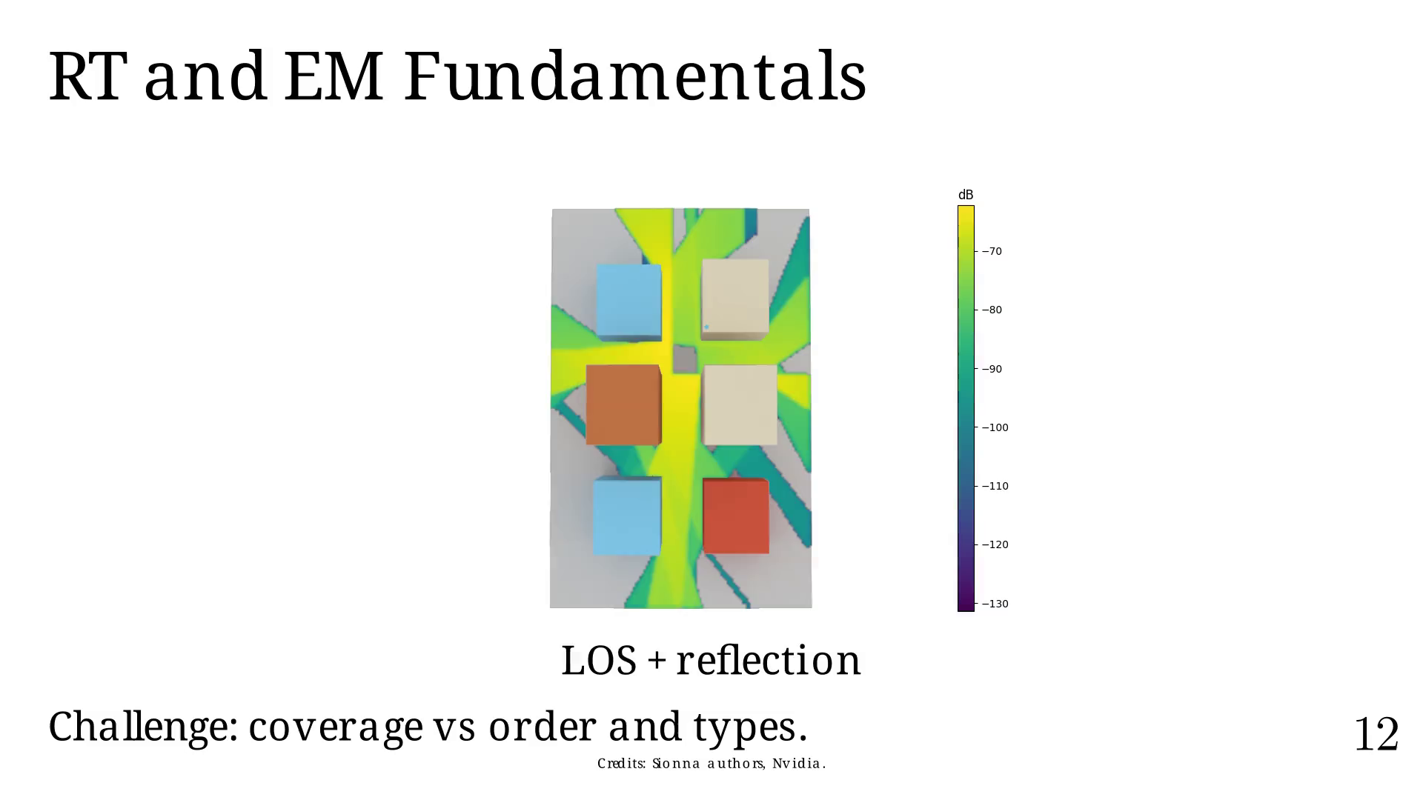
Notes:
If we add diffraction.

Slide 46
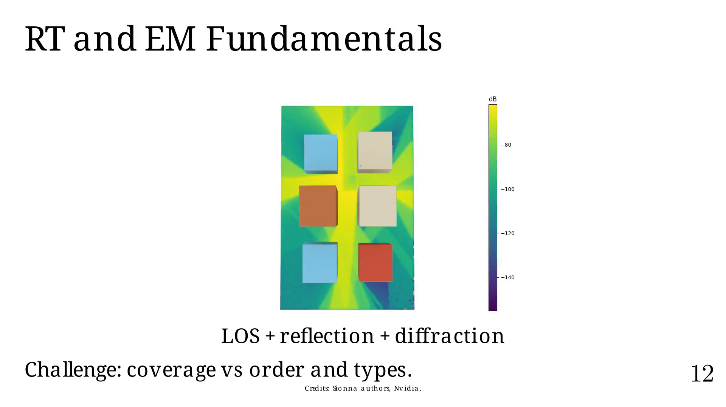
Notes:
Or if we add scattering.

Slide 47
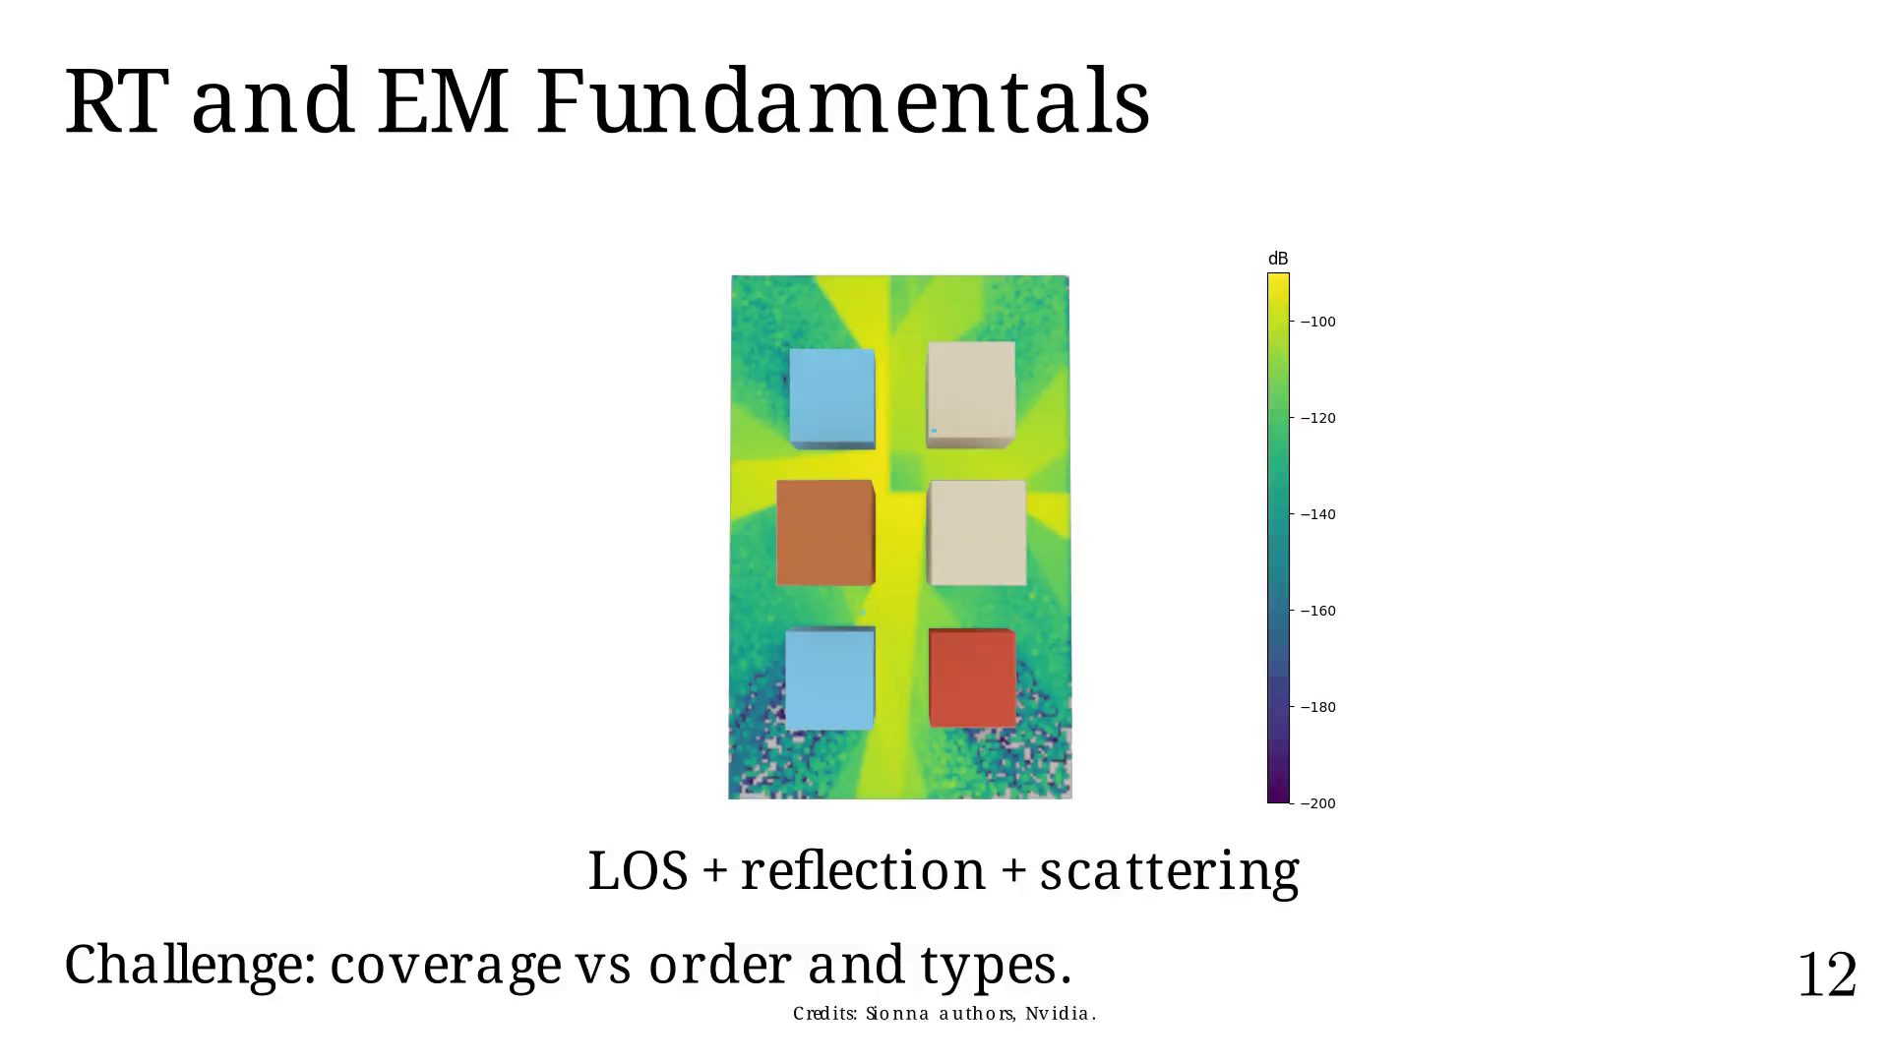
Notes:
Listing RT applications,
with graphics being the most active community in DRT.

Slide 48
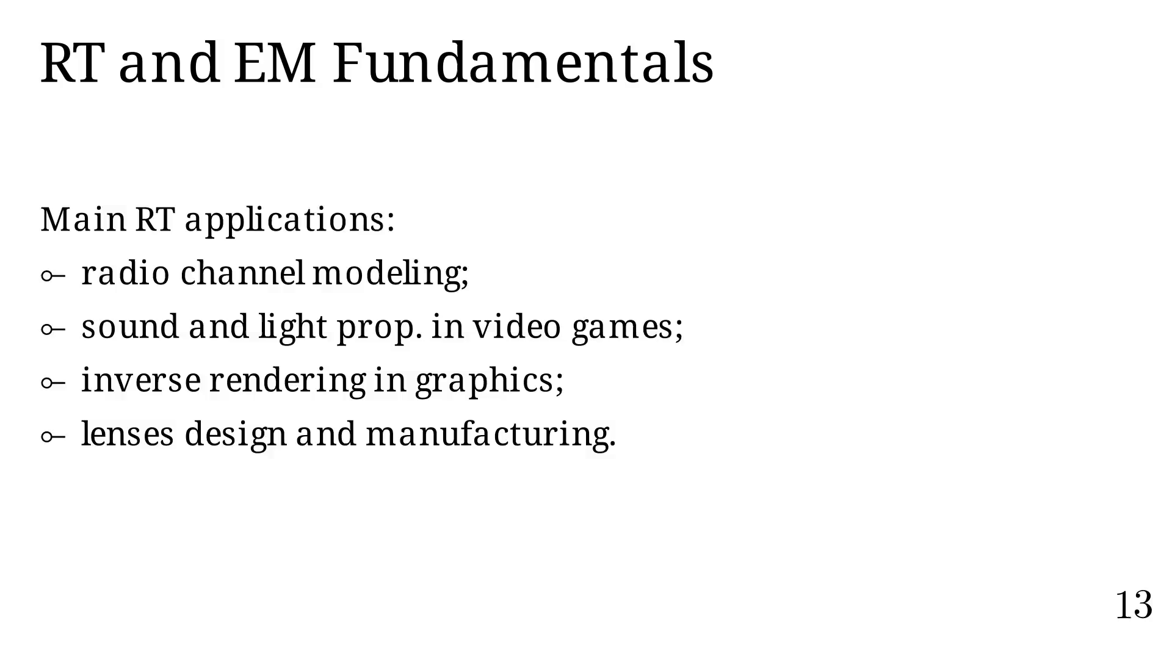
Notes:
Listing other channel modeling methods.
RT provides a good trade-off between accuracy, speed,
and interpretability of the model.
We currently mainly use RL, a variant of RT,
which we will describe later.

Slide 49
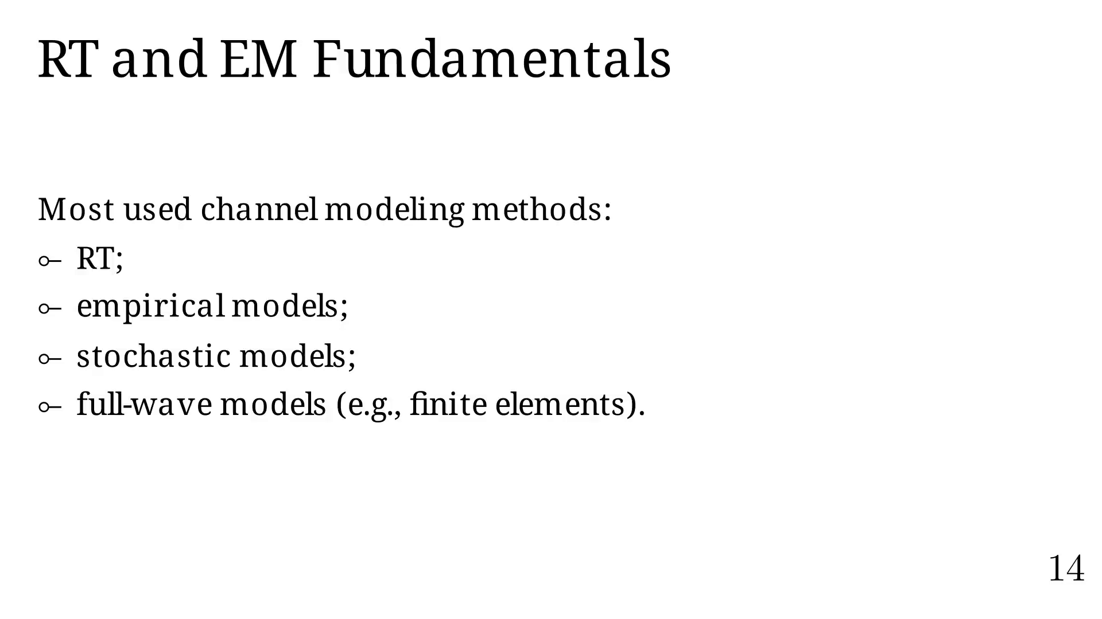
Notes:
Let us motivate this thesis subject.

Slide 50
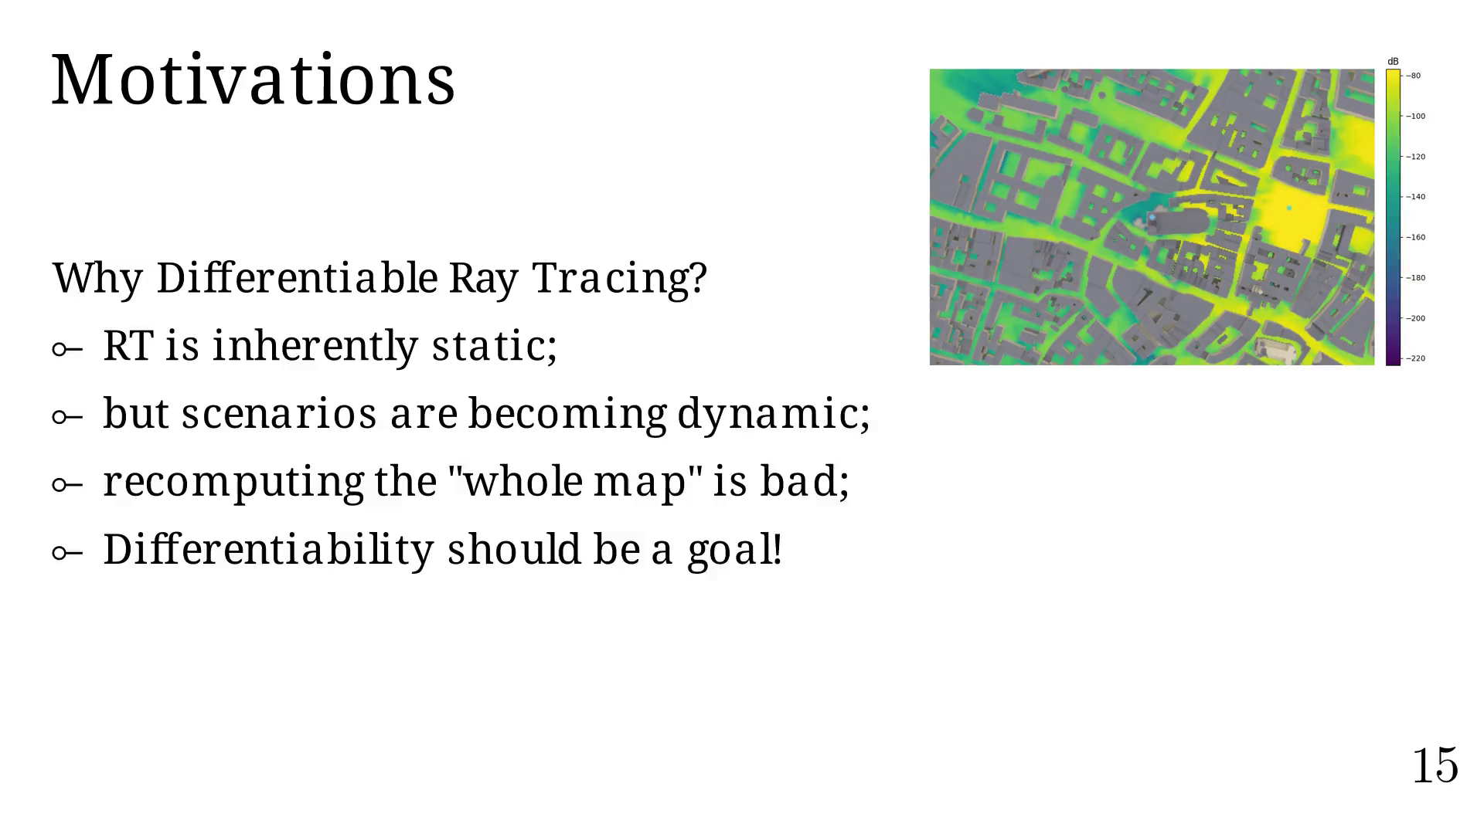
Notes:
Recall the example from before (RL).
When launching rays, most of them will never reach the UE.

Slide 51
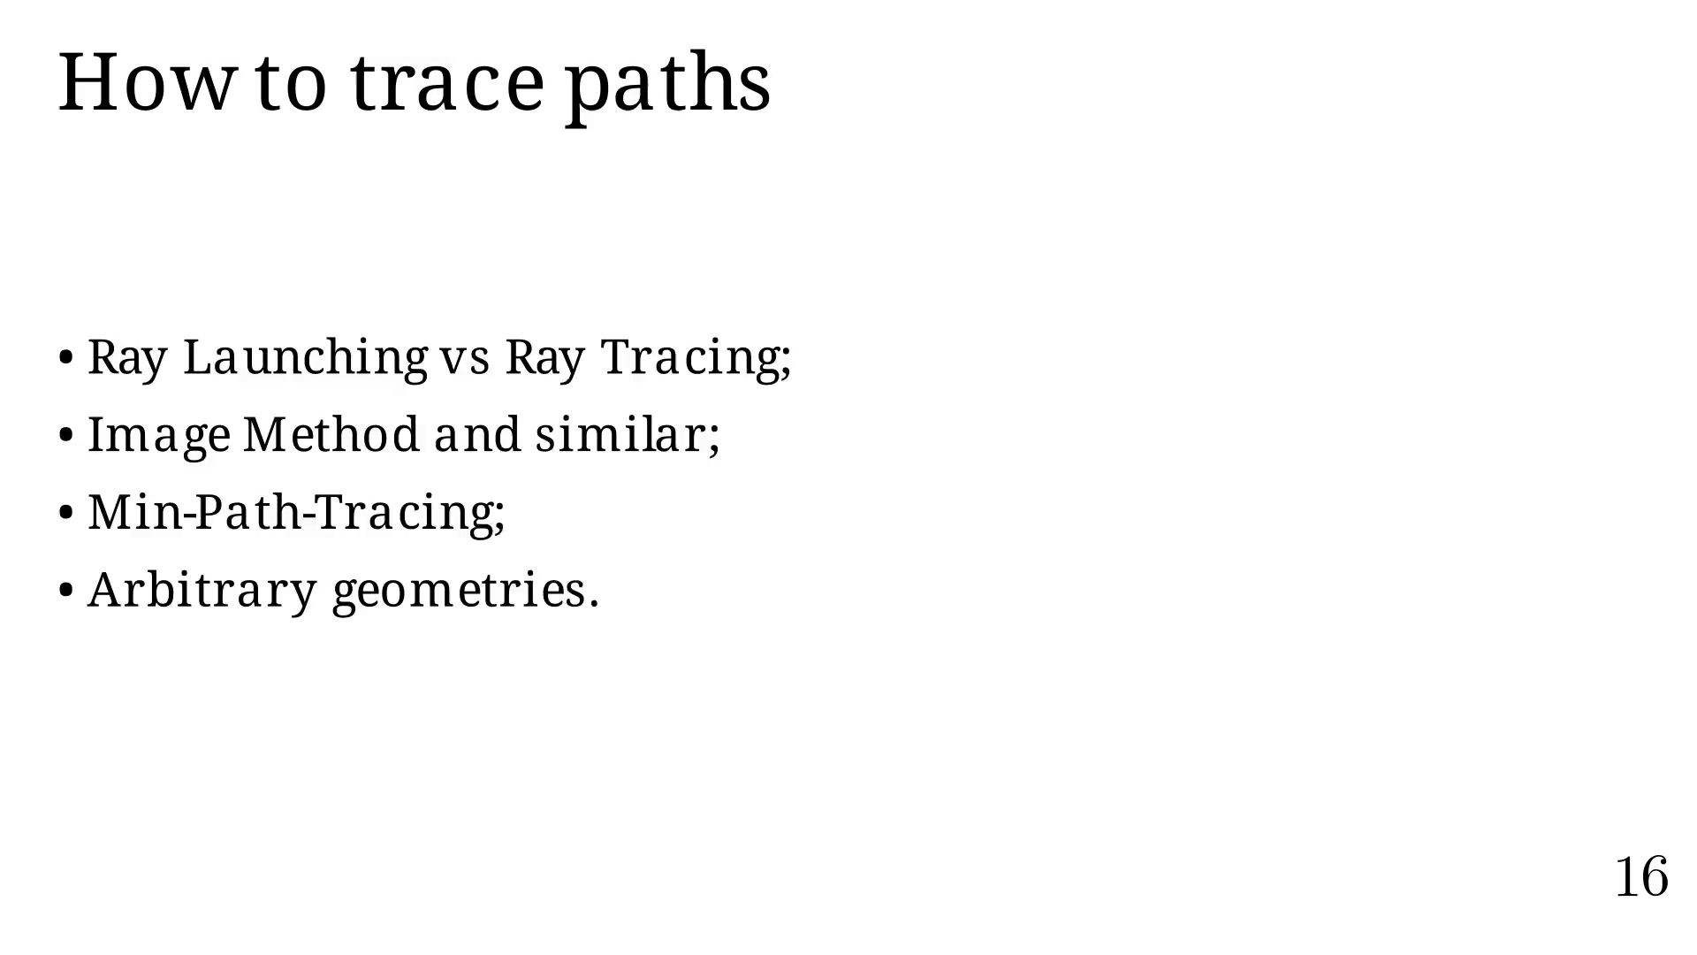
Notes:
Let's go back to our first example.

Slide 52
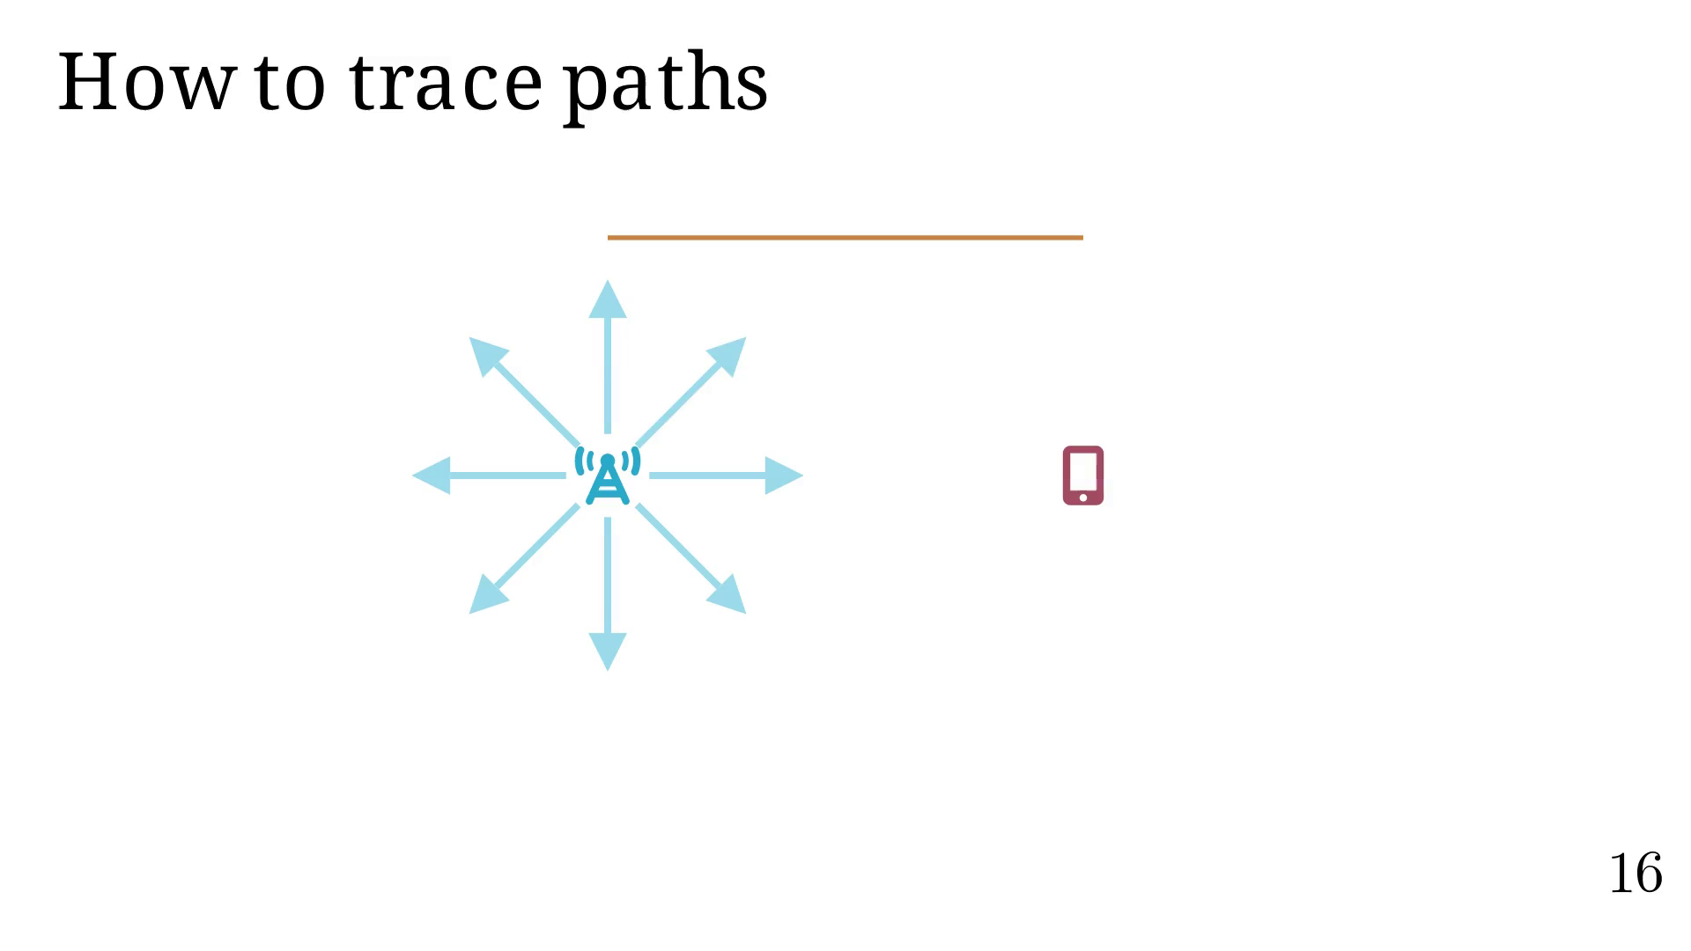
Notes:
Only one ray reaches UE.

Slide 53
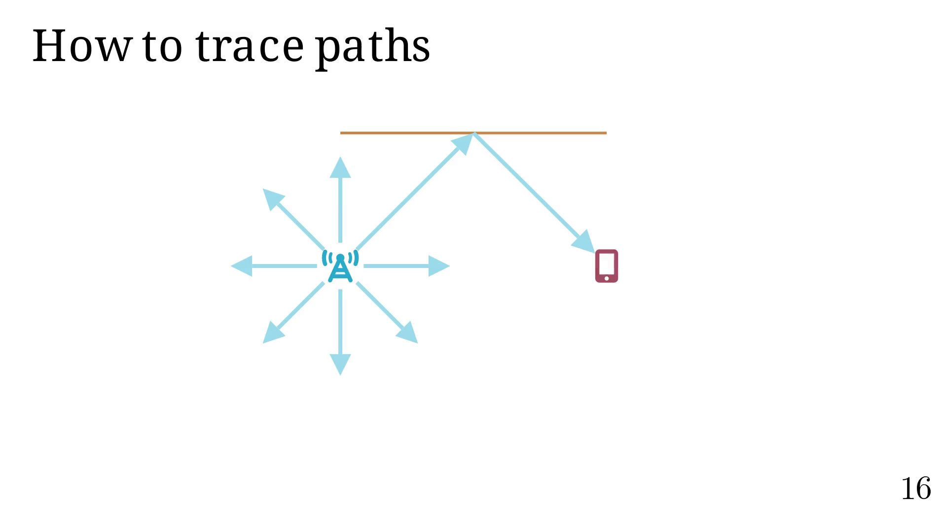
Notes:
But what if UE was slightly off?

Slide 54
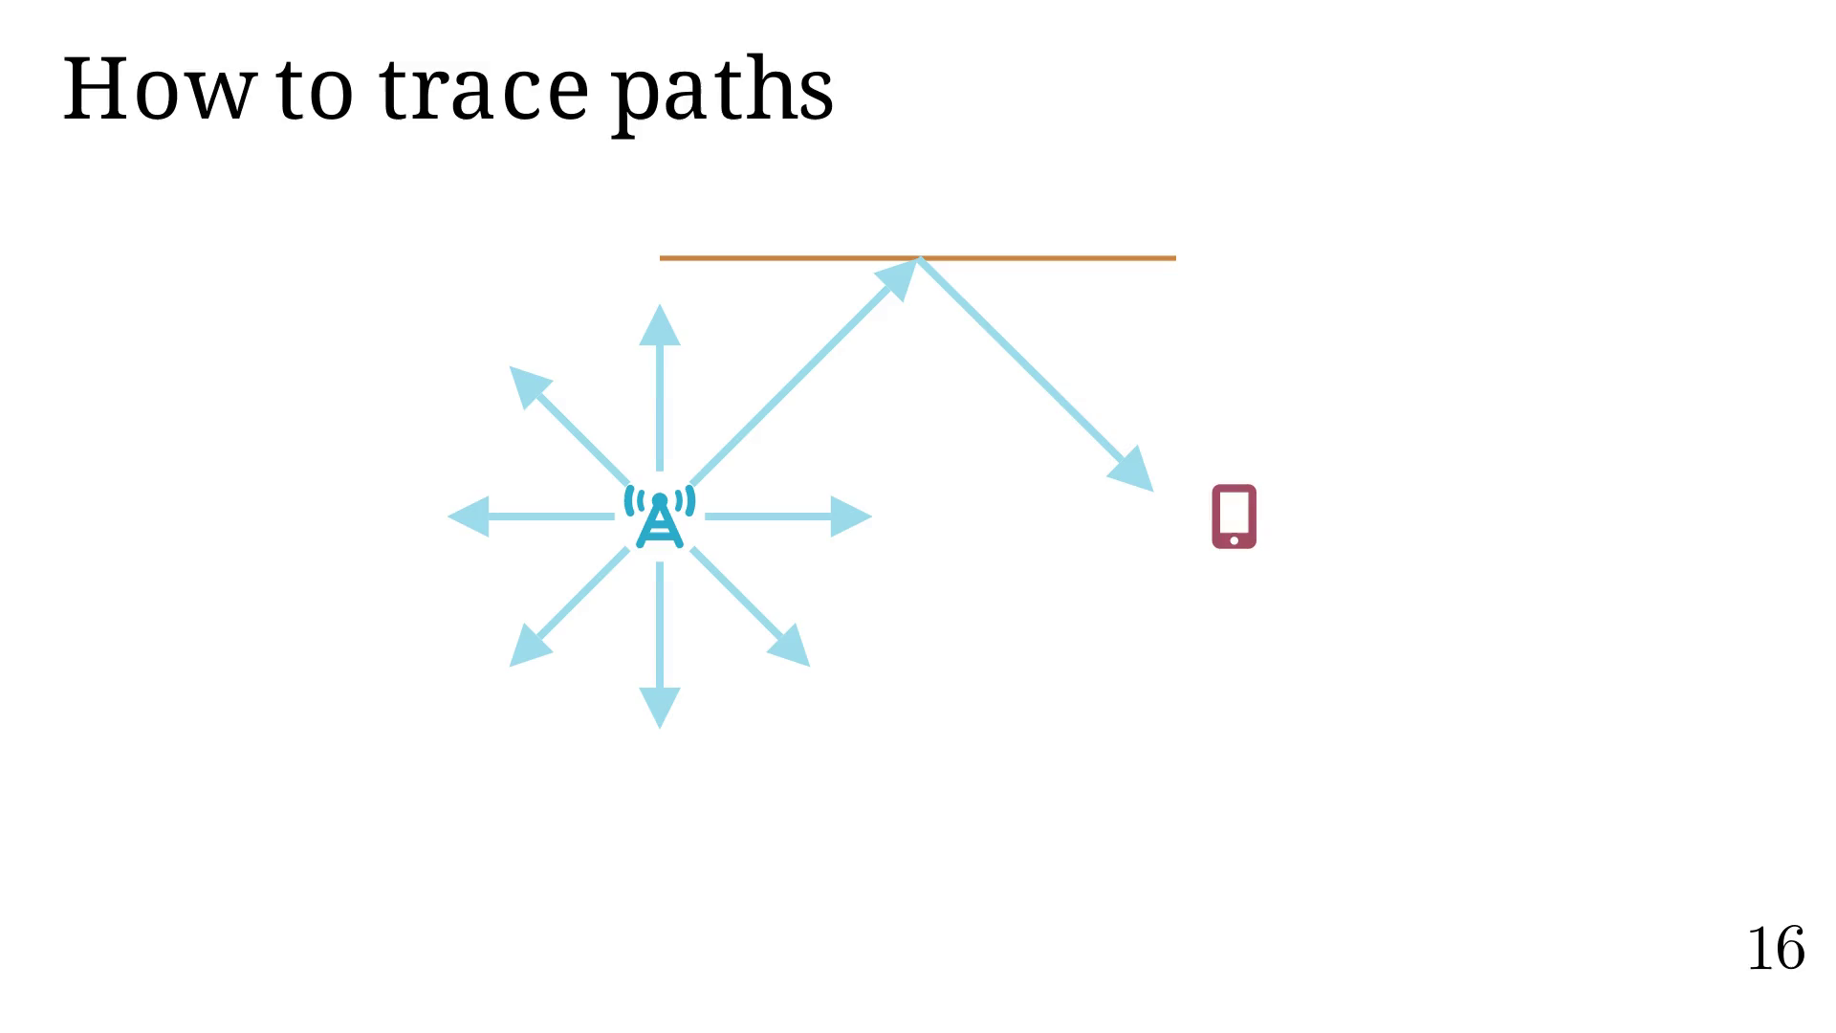
Notes:
You could create a larger 'inclusion' sphere.

Slide 55
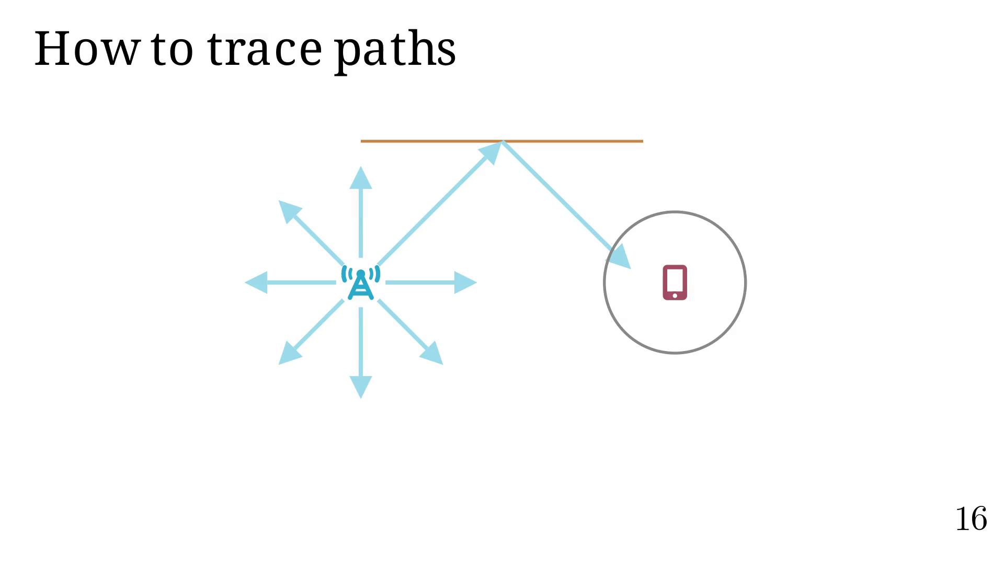
Notes:
Or launch more rays.

Slide 56
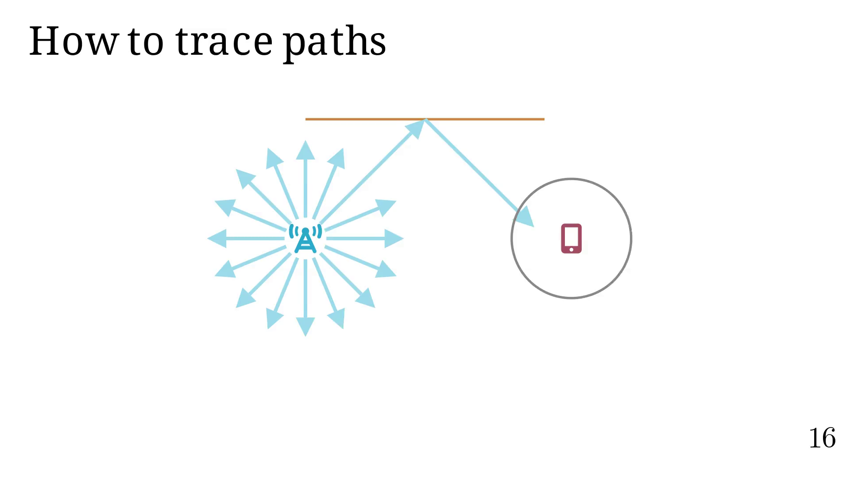
Notes:
Not very efficient!

Slide 57

Notes:
How to exactly find paths?

Slide 58

Notes:
Let's introduce the Image Method.

Slide 59

Notes:
Checking LOS.

Slide 60

Notes:
Computing the first image.

Slide 61

Notes:
Computing the second image.

Slide 62

Notes:
Computing the second coordinate.

Slide 63

Notes:
Computing the first coordinate.

Slide 64


Slide 65

Notes:
RL - RT comparison

Slide 66

Notes:
What if we want to simulate something else
than reflection on planar surfaces?

Slide 67

Notes:
Treating each interaction individually.

Slide 68

Notes:
Adding angles

Slide 69


Slide 70


Slide 71


Slide 72


Slide 73


Slide 74


Slide 75


Slide 76


Slide 77


Slide 78


Slide 79


Slide 80


Slide 81


Slide 82


Slide 83


Slide 84


Slide 85


Slide 86


Slide 87

Notes:
See how MPT is applied in 3D.

Slide 88


Slide 89

Notes:
RL - RT comparison

Slide 90

Notes:
Differentiable Ray Tracing part!

Slide 91

Notes:
How to compute derivatives?

Slide 92

Notes:
Our problem is only piecewise diff. and continuous.

Slide 93

Notes:
Constraints about our approximation.

Slide 94

Notes:
Examples.

Slide 95


Slide 96


Slide 97


Slide 98


Slide 99

Notes:
Let's animate alpha.

Slide 100

Notes:
Thanks to that, and other things, we can create a fully DRT!

Slide 101

Notes:
We can create an optimization problem.

Slide 102

Notes:
Let's see how it converge.
Actually, tests have shown:
1.5 to 2 increase in success rate,
where 92% to 98% of already successful runs still converge
with our method.

Slide 103

Notes:
Now, we will take a look at the status of work.

Slide 104

Notes:
Let us review the initial goals.

Slide 105


Slide 106

Notes:
Updated Gantt diagram.

Slide 107

Notes:
Let us review the work achieved so far.

Slide 108

Notes:
Let us review the work achieved so far.

Slide 109

Notes:
Past and future collaborations.

Slide 110

Notes:
Let's conclude this.

Slide 111

Notes:
Questions time!

Slide 112

Notes:
ML structure.

Slide 113

Notes:
Diffraction.

Slide 114

Notes:
RT runtime.

Slide 115

Notes:
Keller cone.

Slide 116

Notes:
Edge diffraction.

